Slide 1
Recurring Delay Windows by Airline, Day of Week
Arrivals VS. Departures

Slide 2
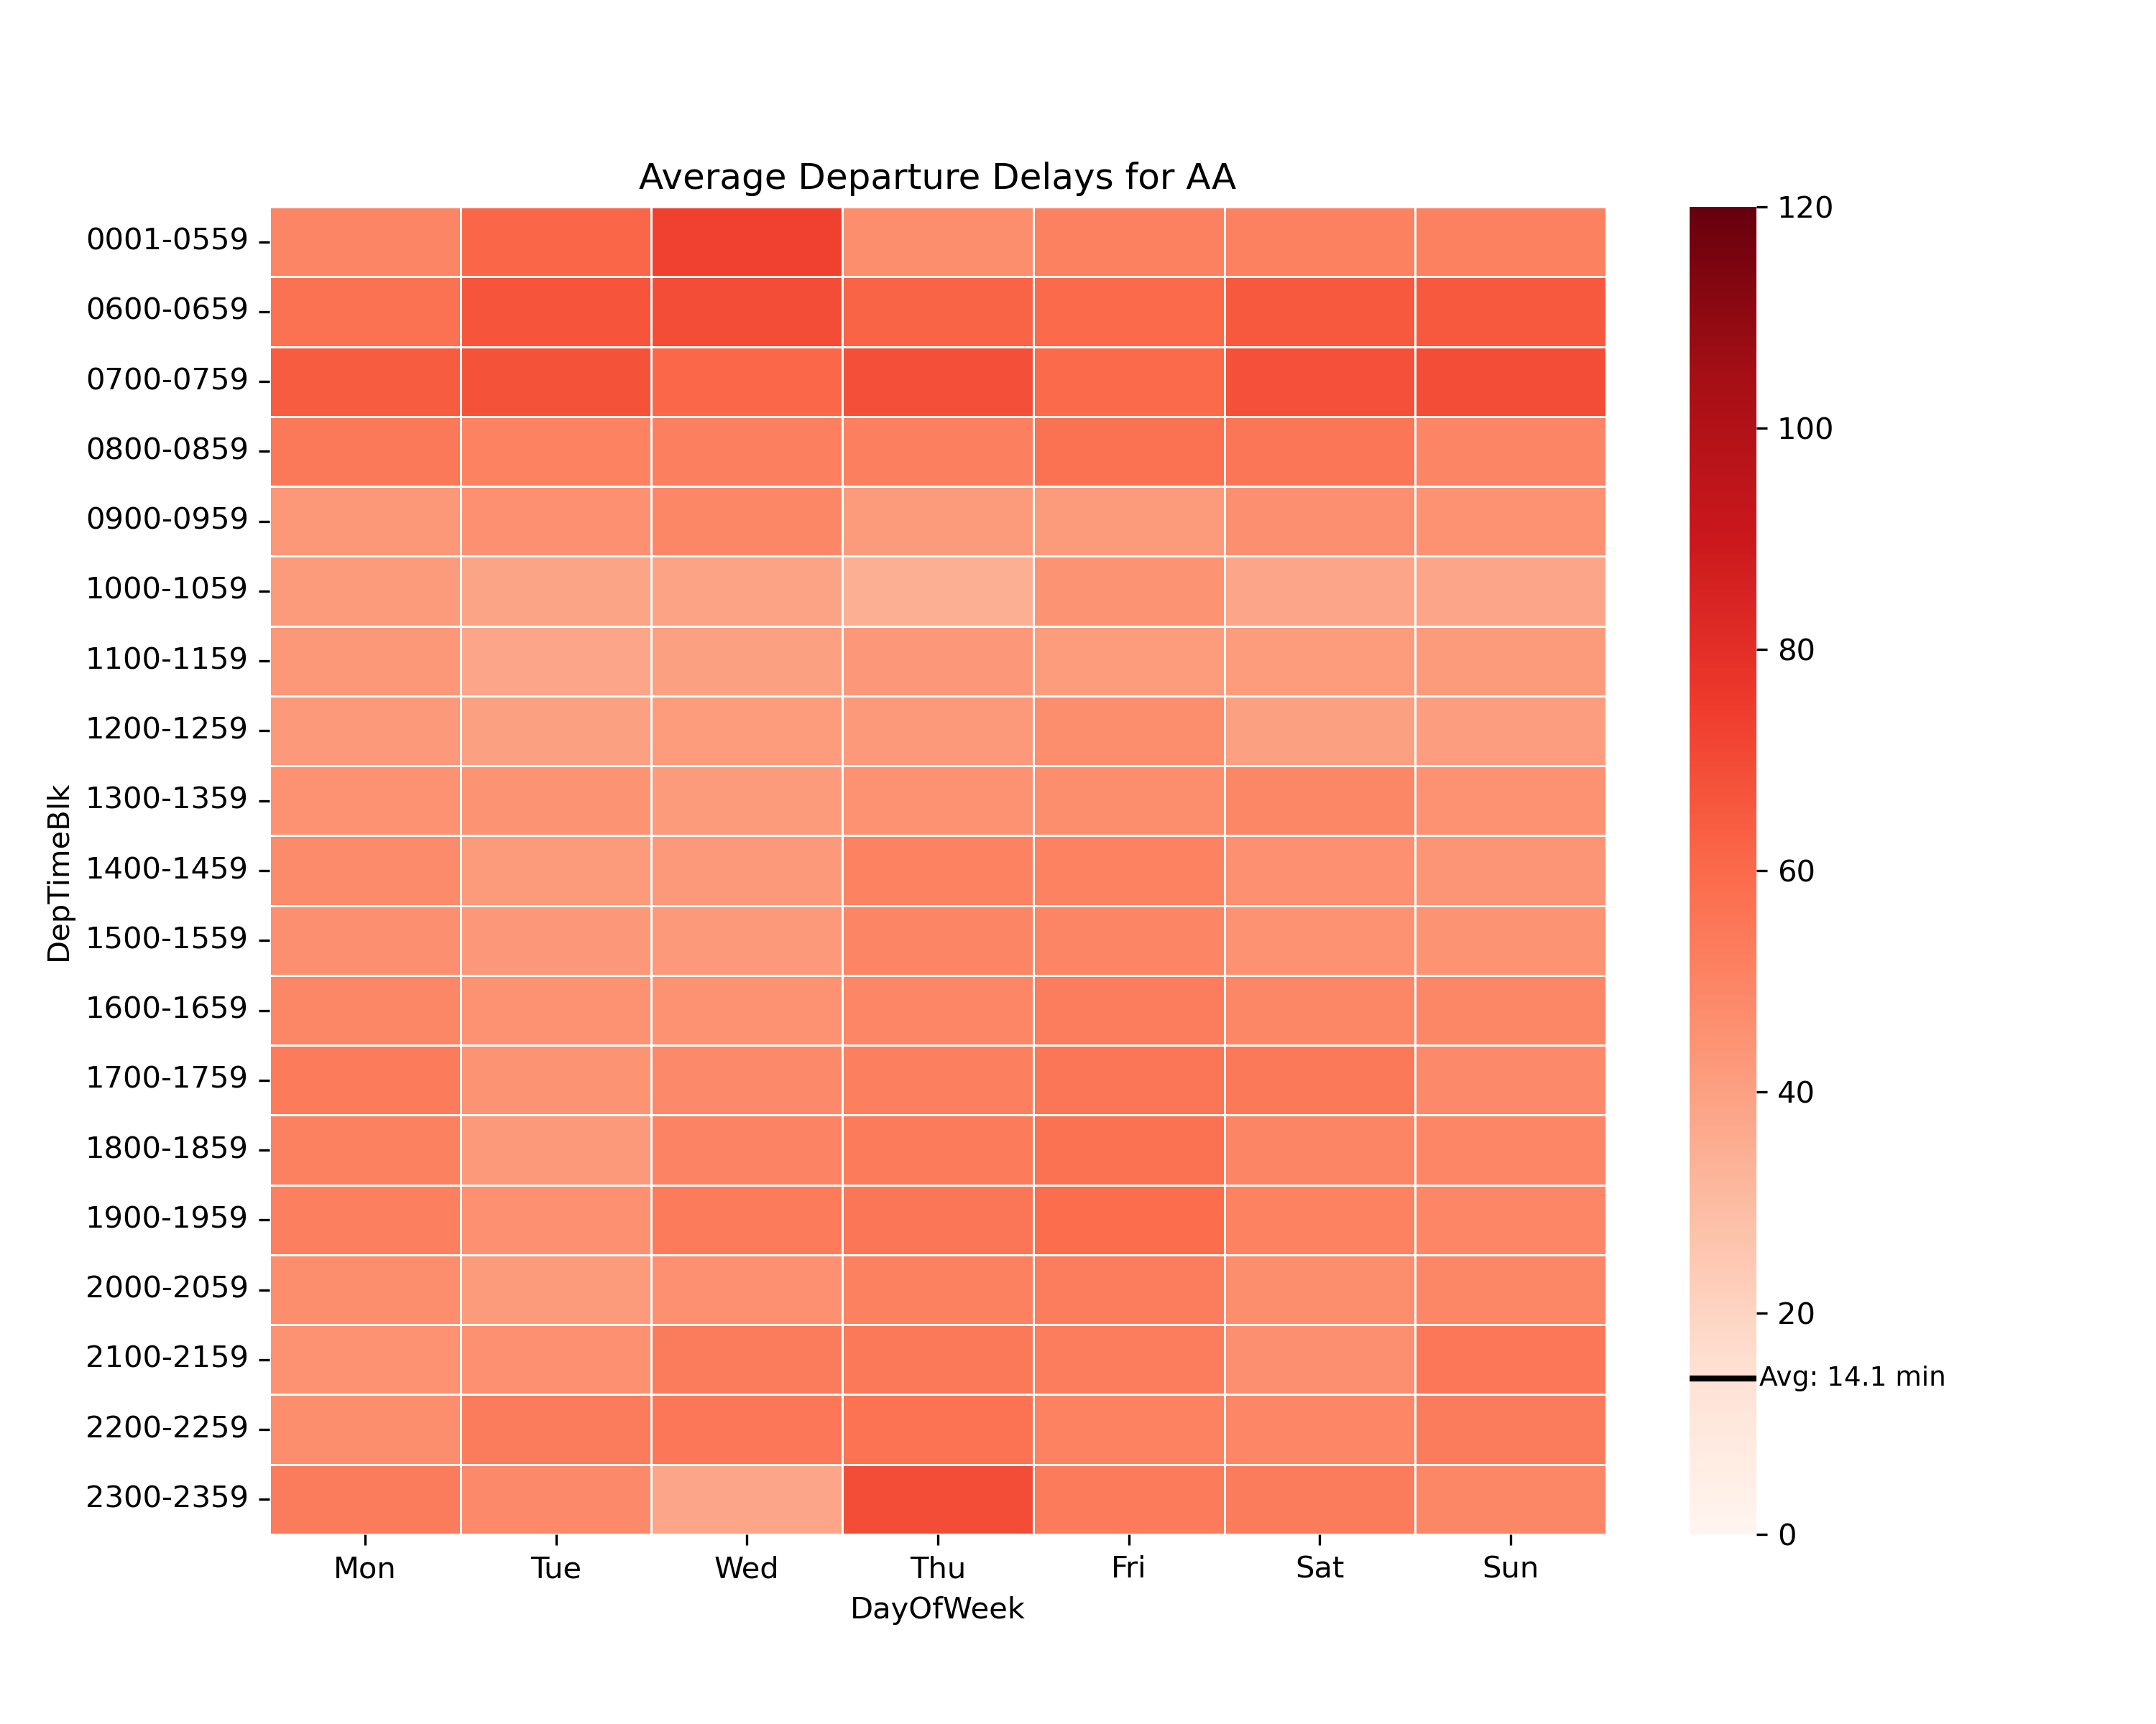
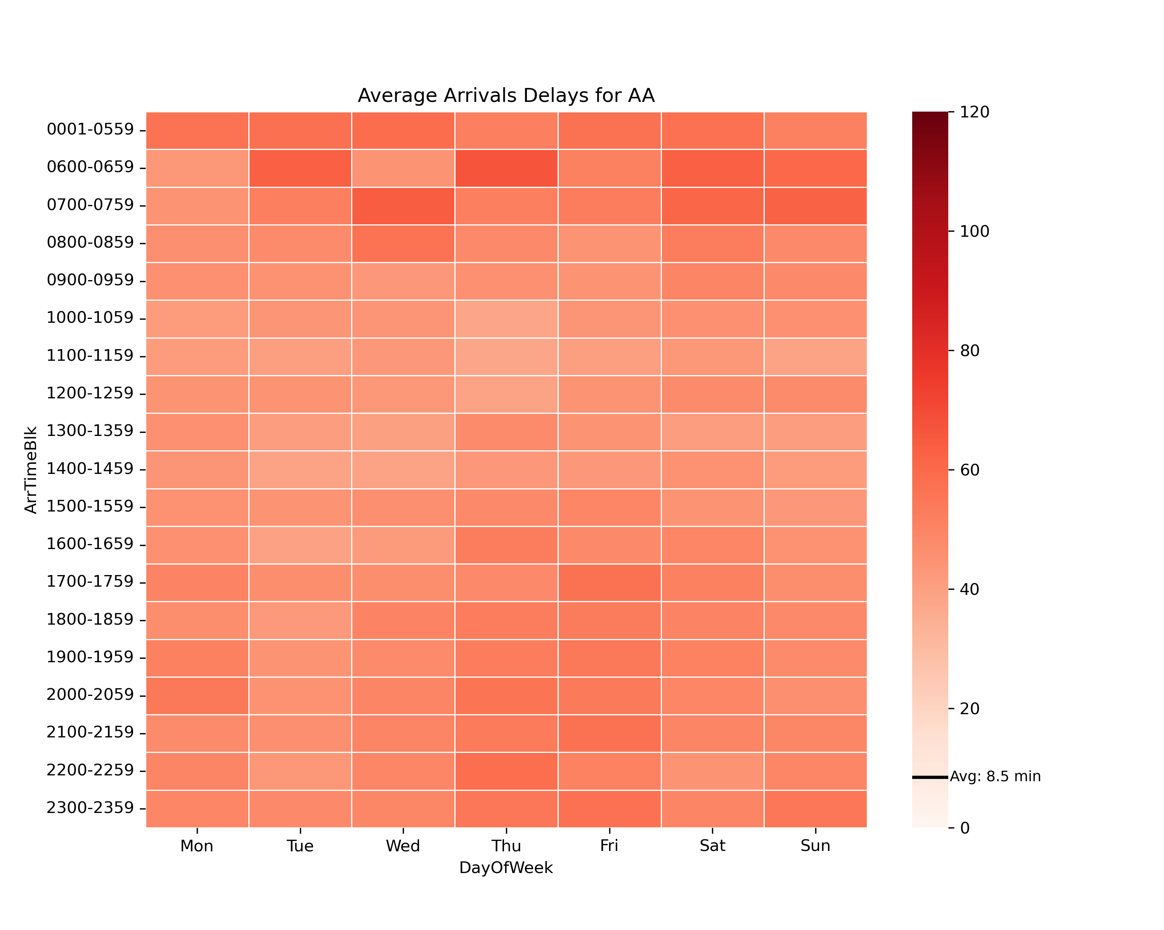
AA
~1hr delays all around, worse in mornings

Slide 3
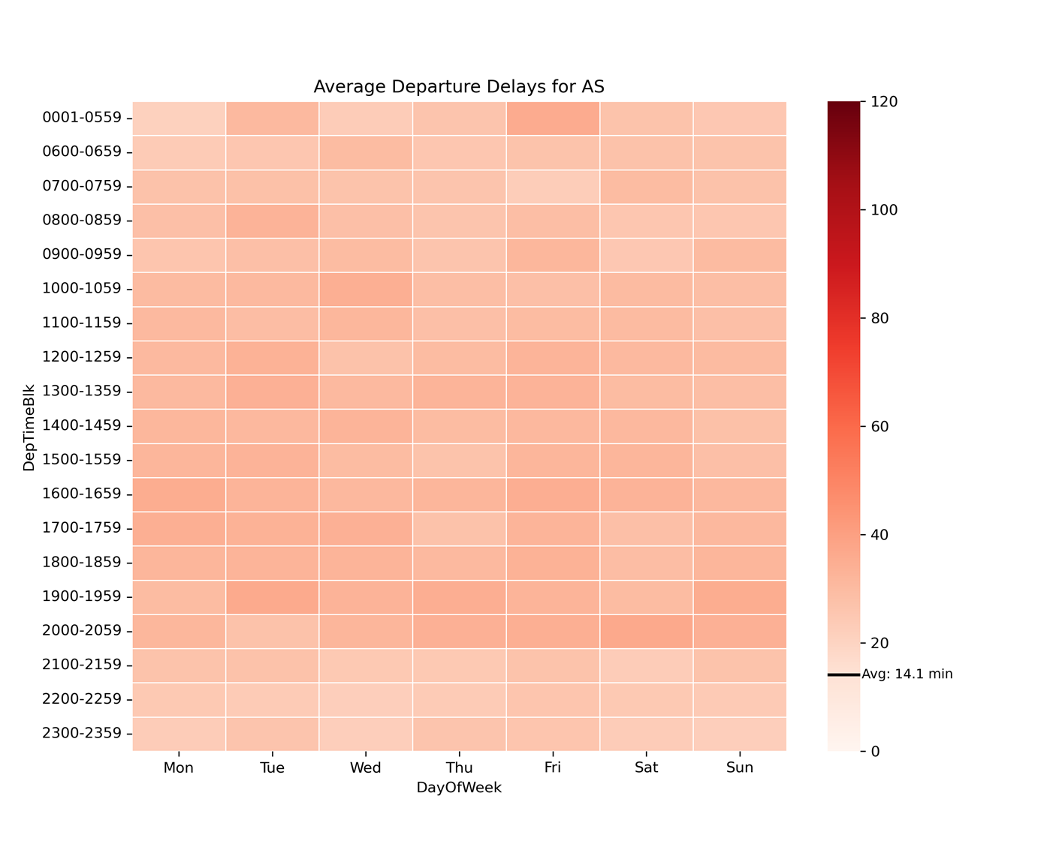
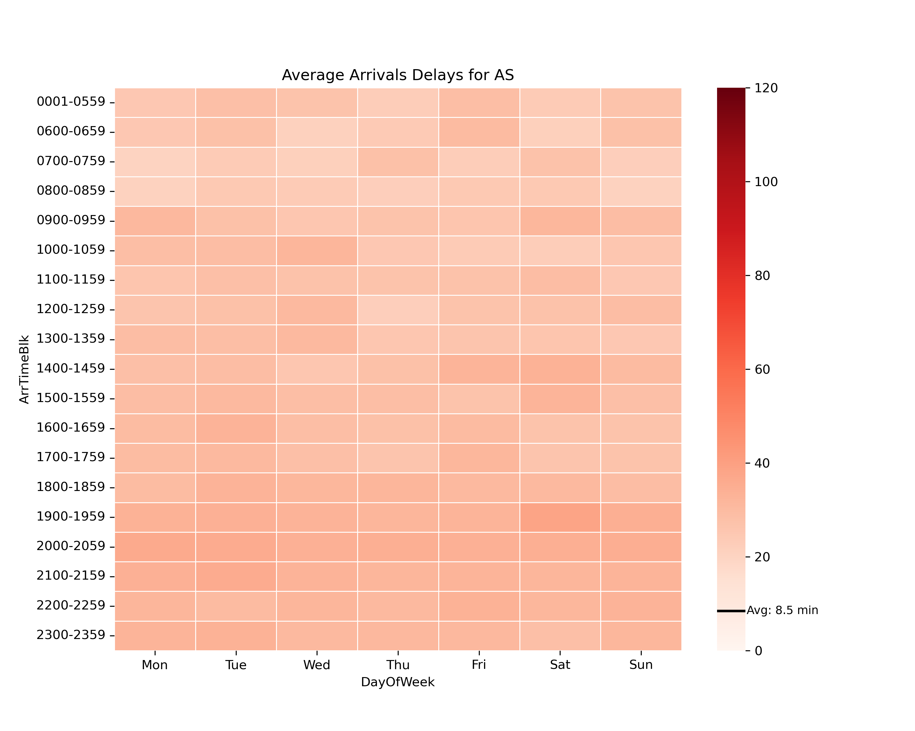
AS
Short delays all around

Slide 4
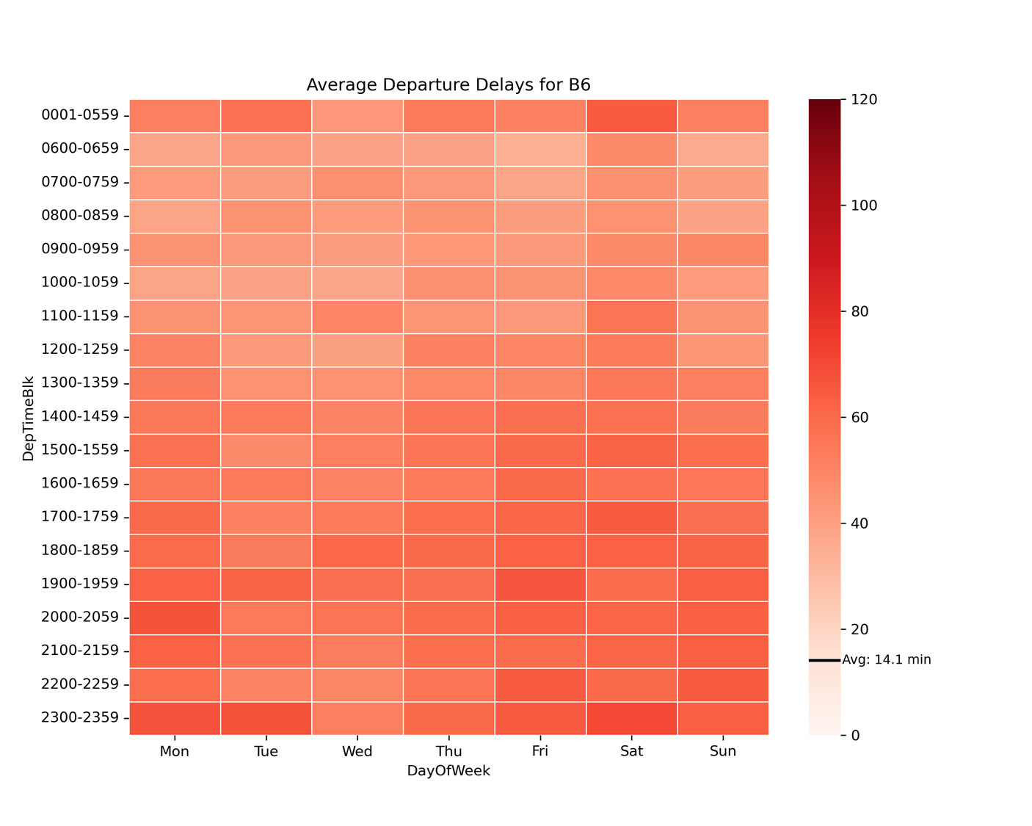
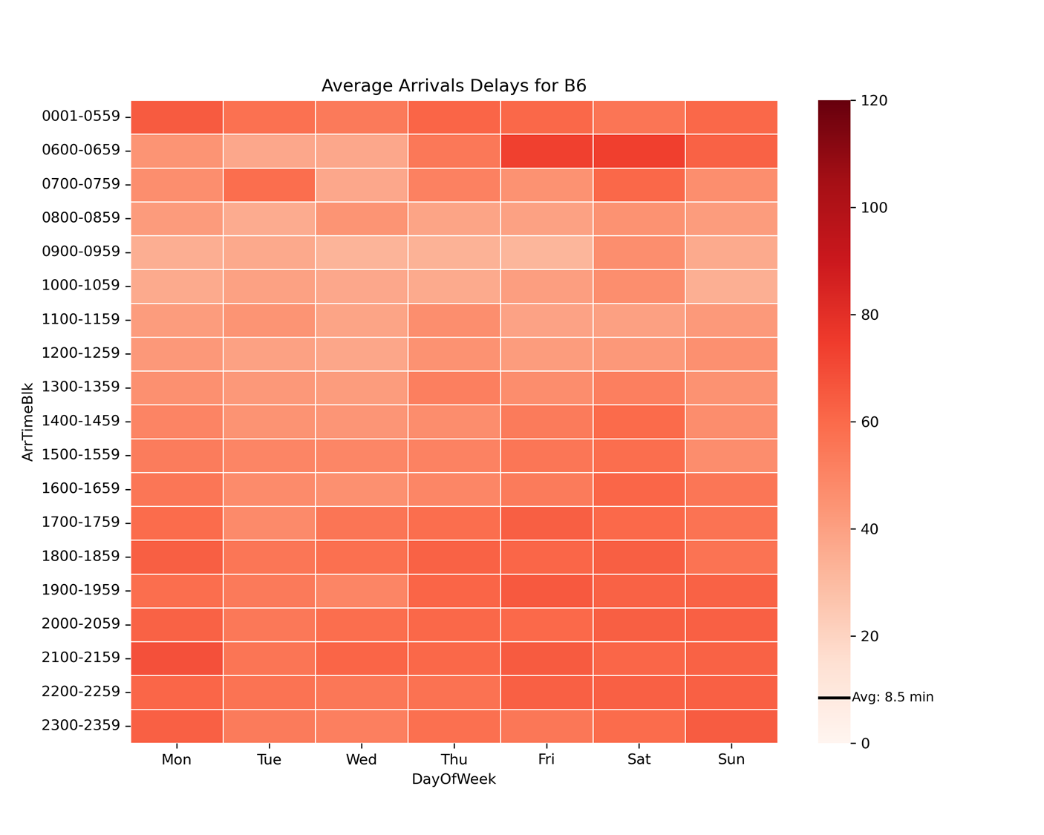
B6
Long delays all around, except in mornings

Slide 5
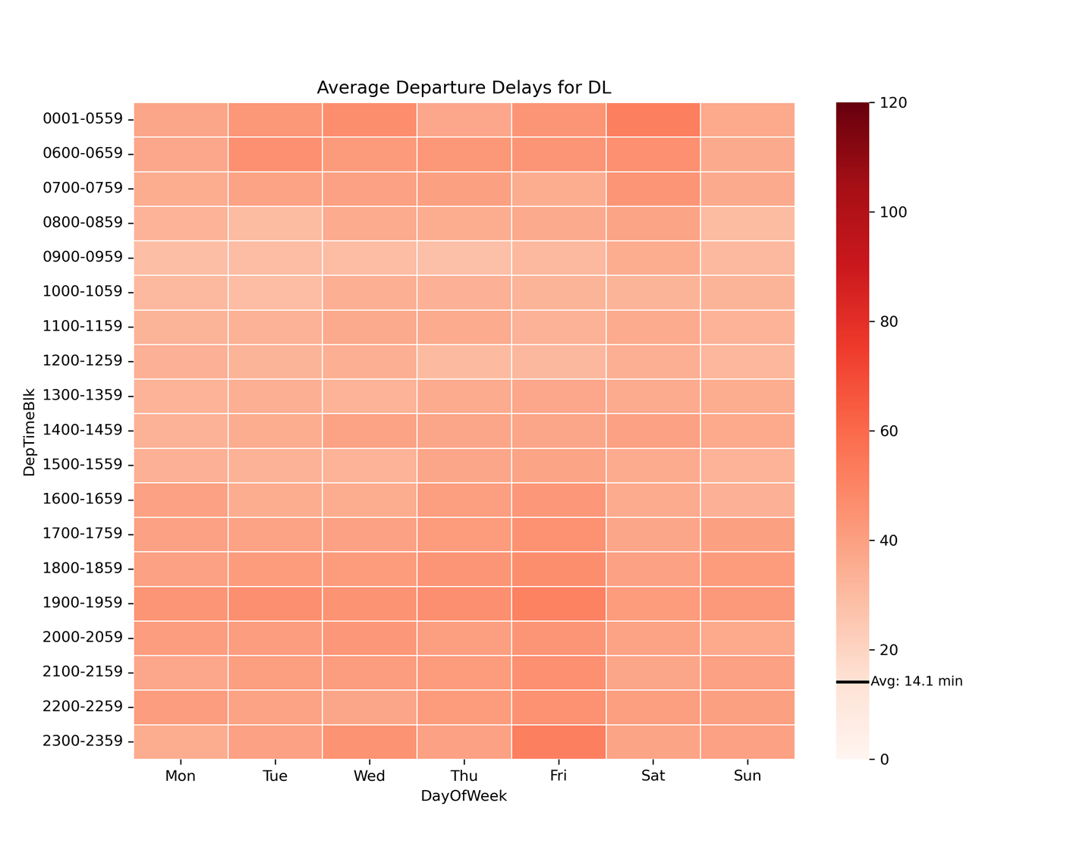
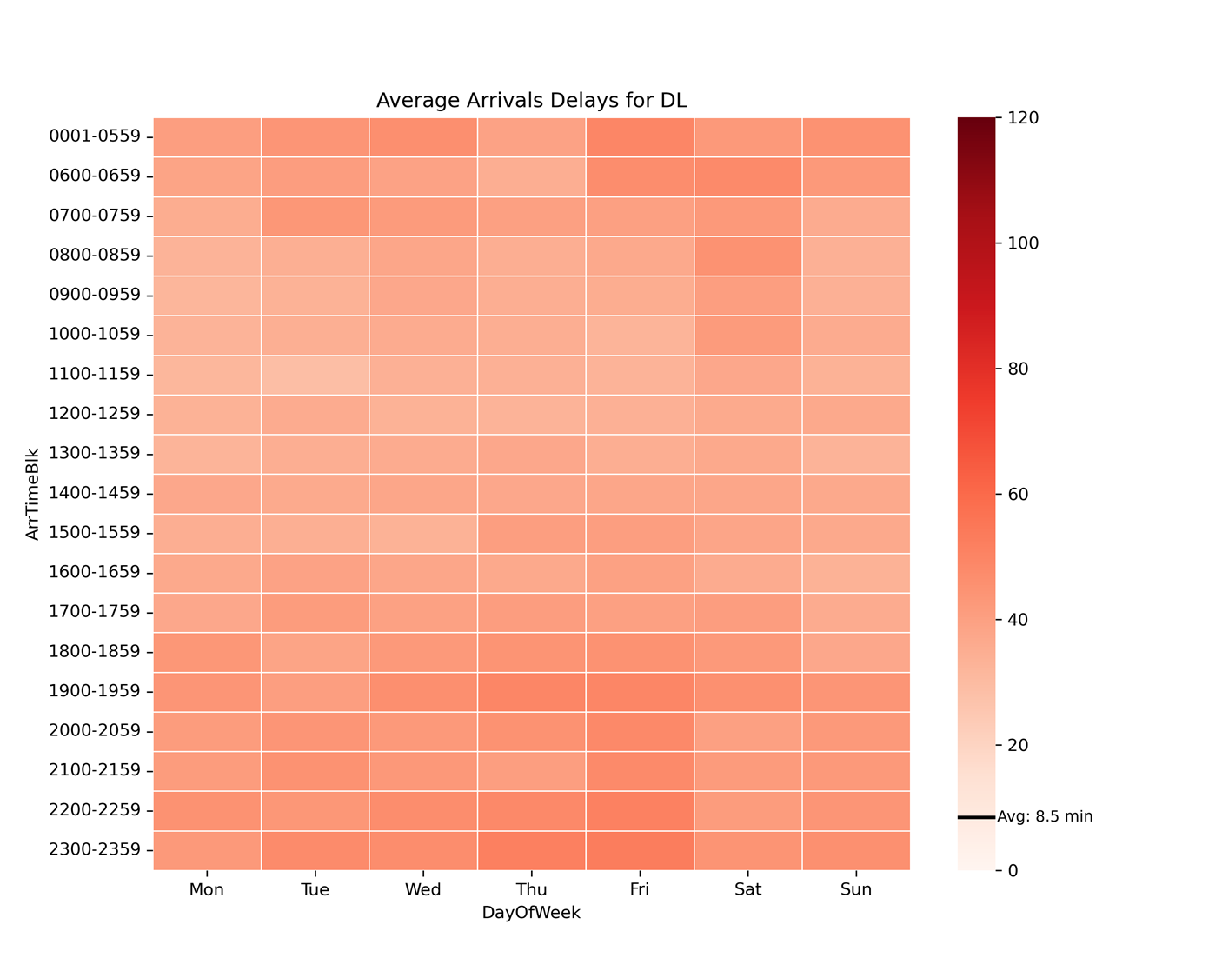
DL
Overall short delays, longer from Friday nights to Saturday mornings

Slide 6
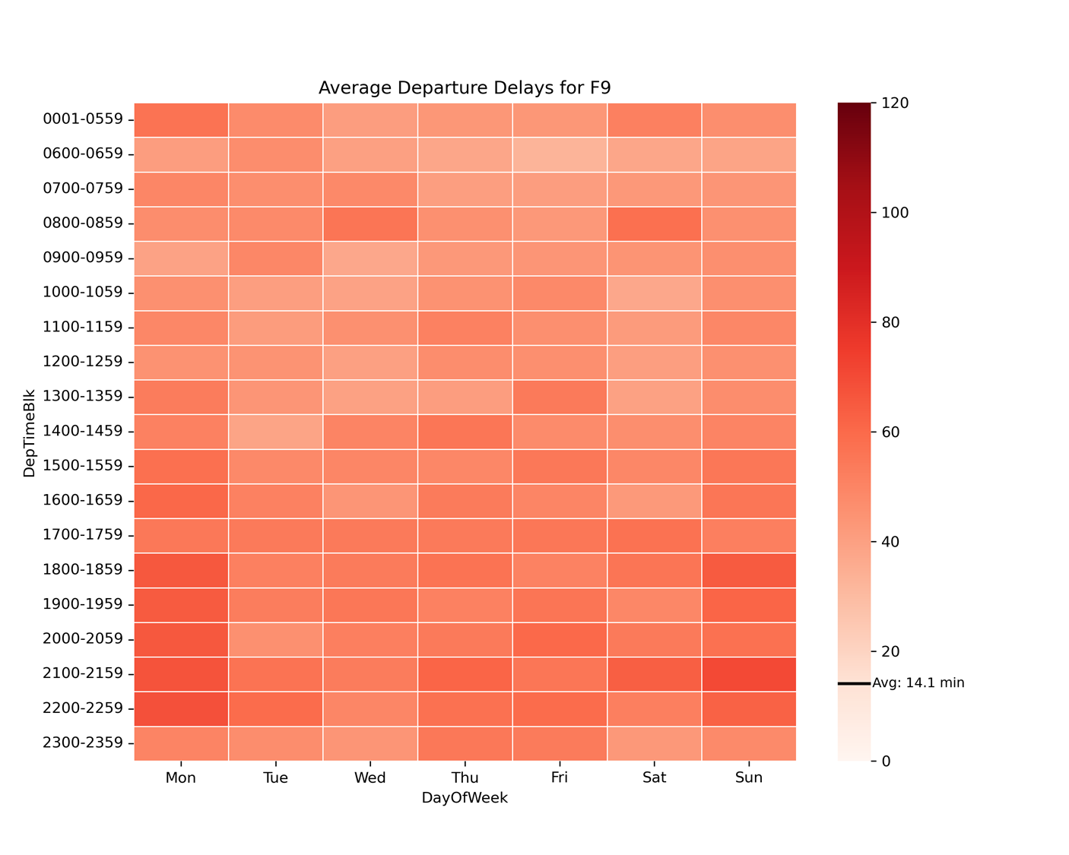
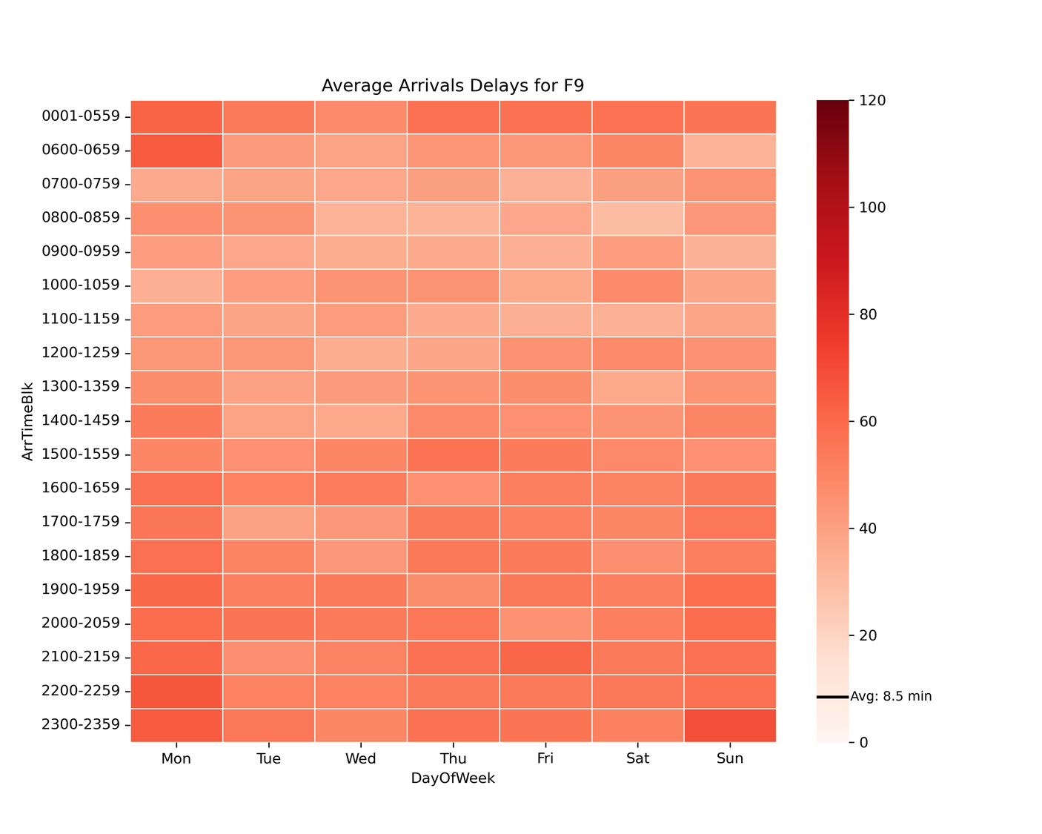
F9
Overall long delays, worse on Sunday evenings/nights and Monday evenings/nights

Slide 7
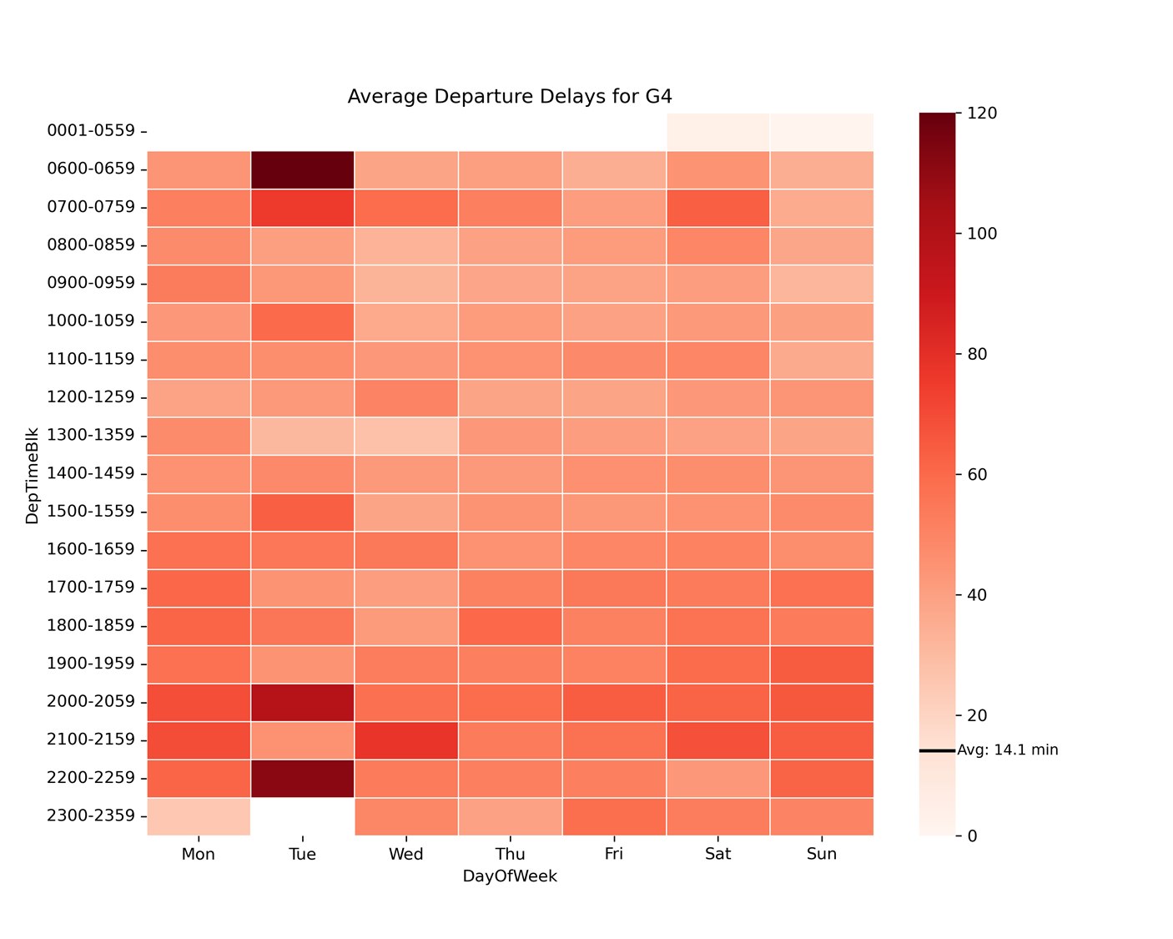
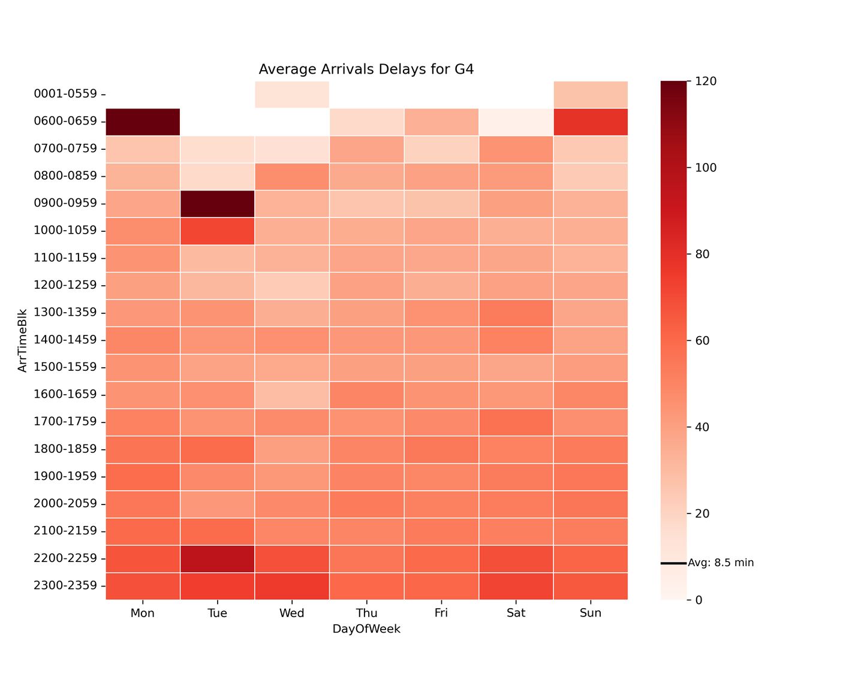
G4
Consistently delayed, especially severe on Tuesdays and on Sunday evenings

Slide 8
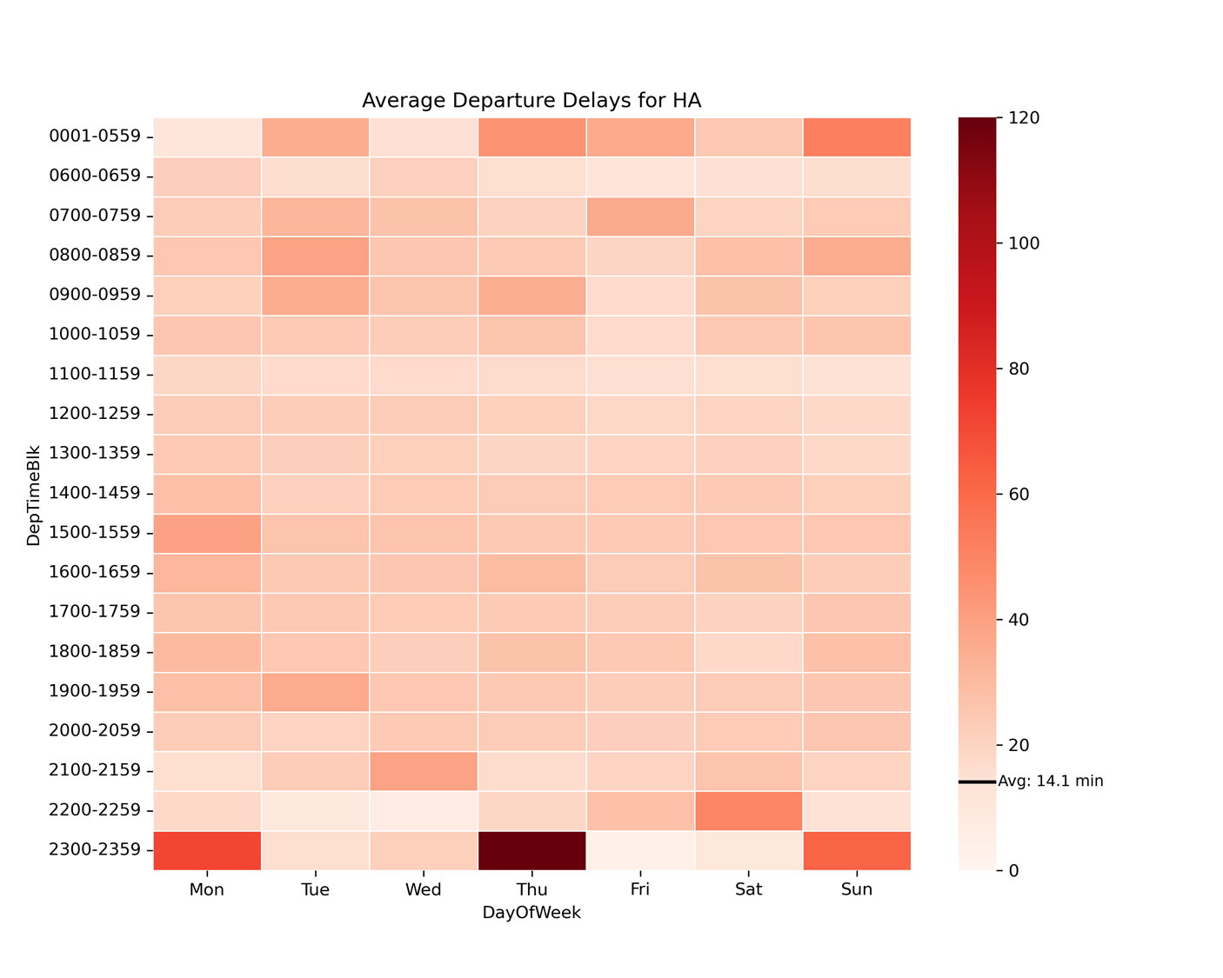
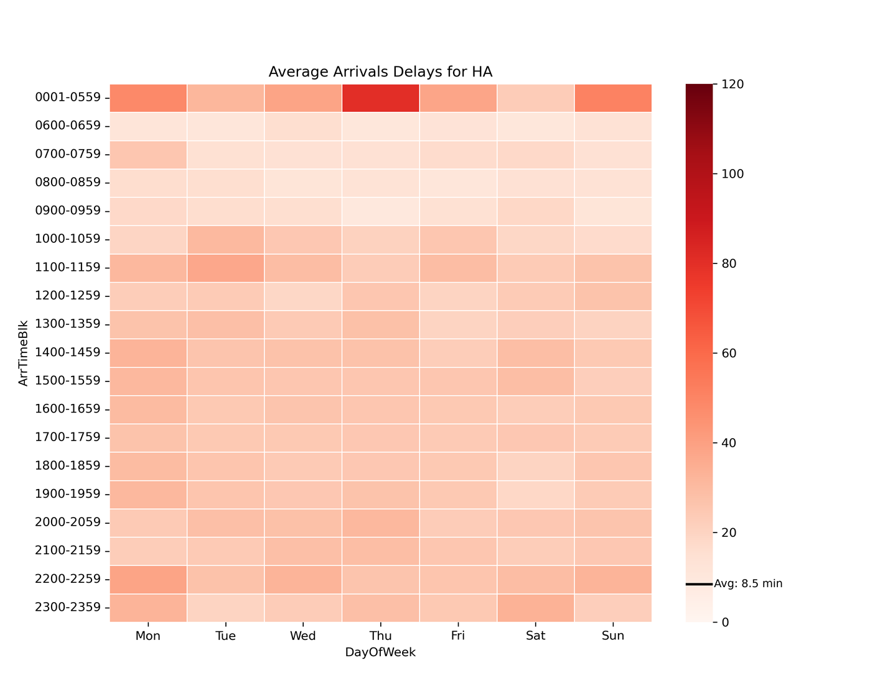
HA
Overall very short delays, problems with Monday, Thursday and Sunday evenings

Slide 9
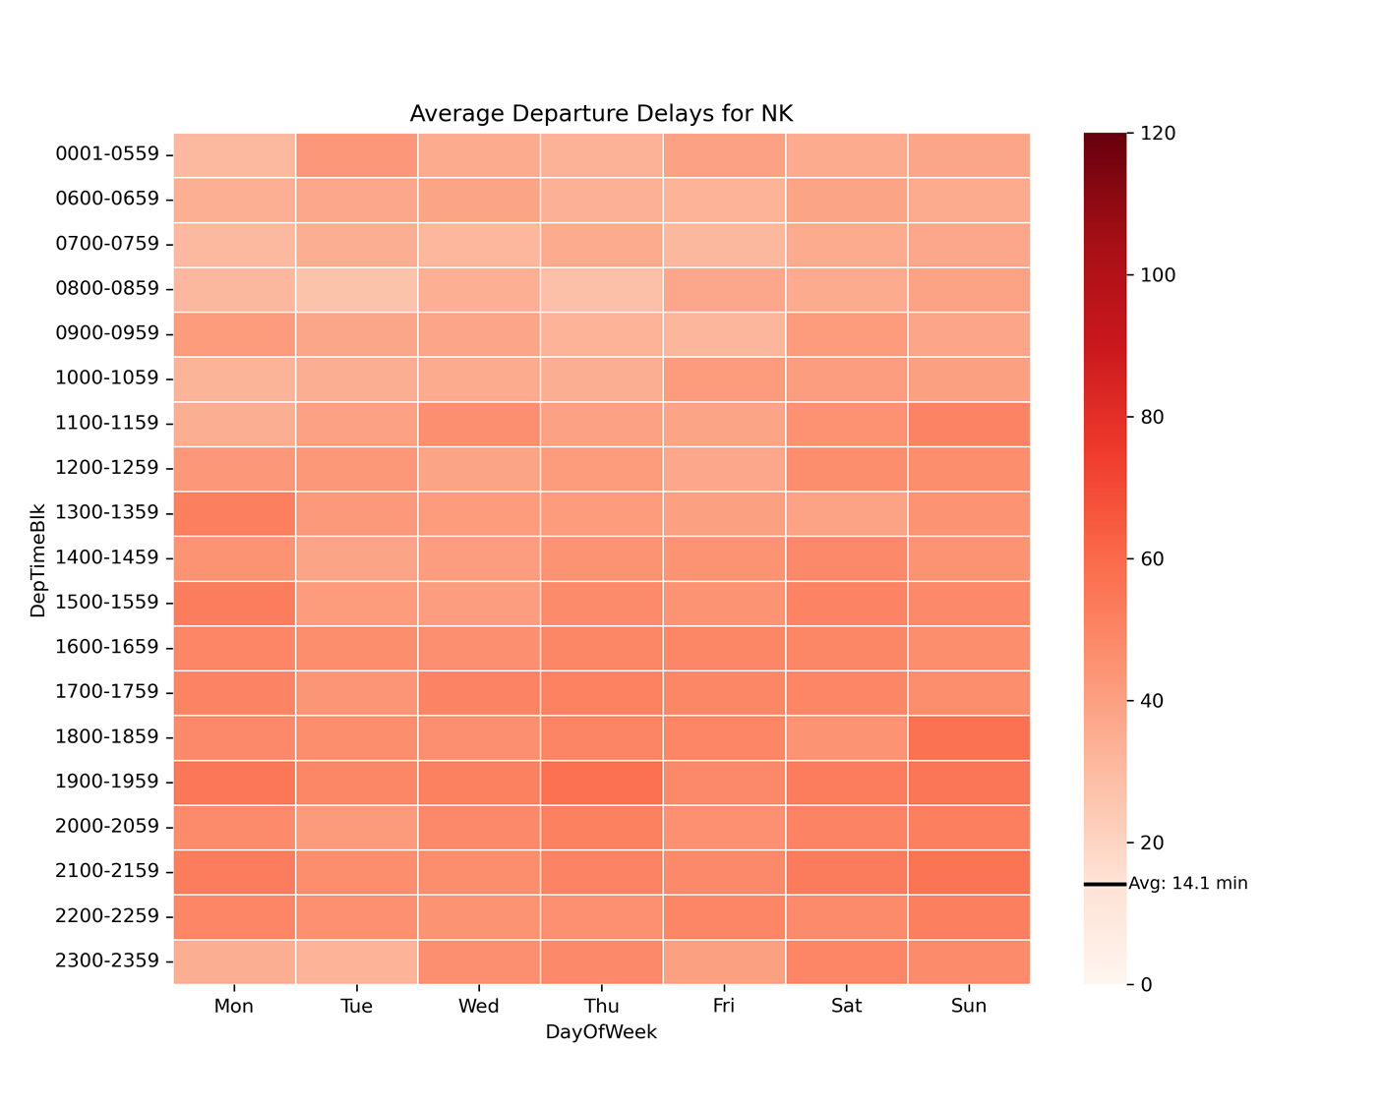
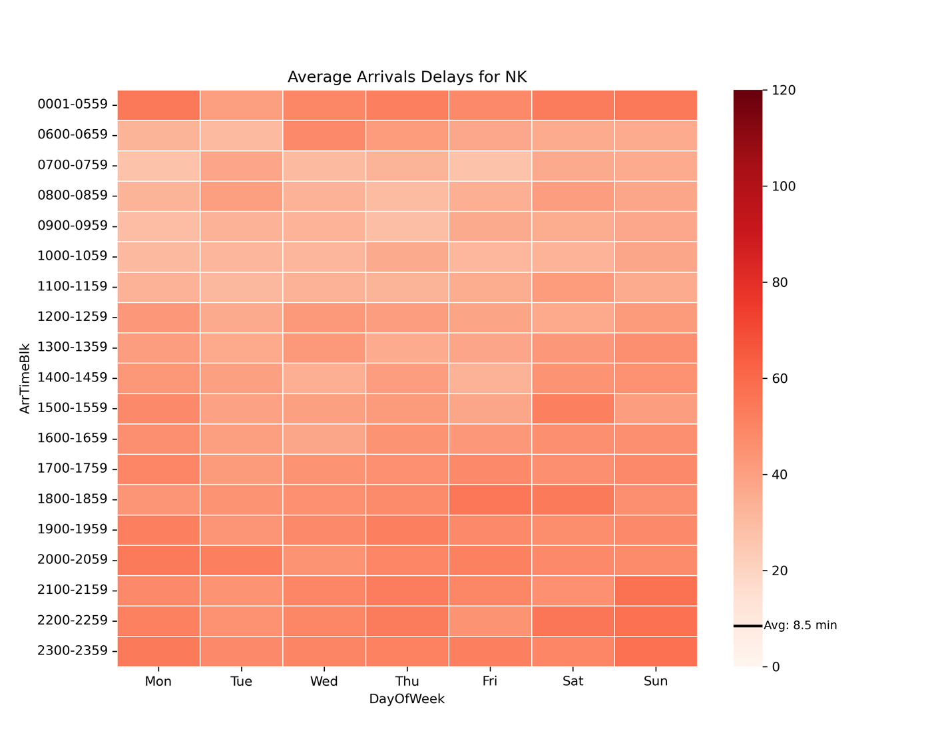
NK
Consistently longer delays in the evenings

Slide 10
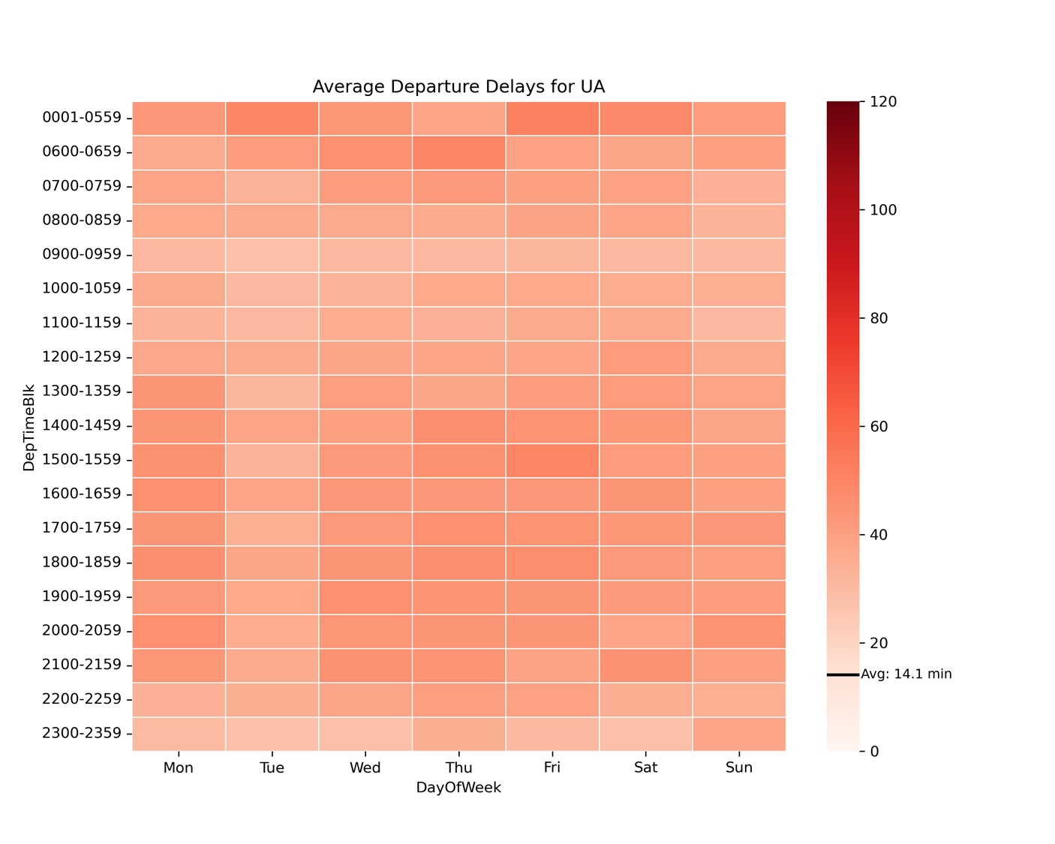
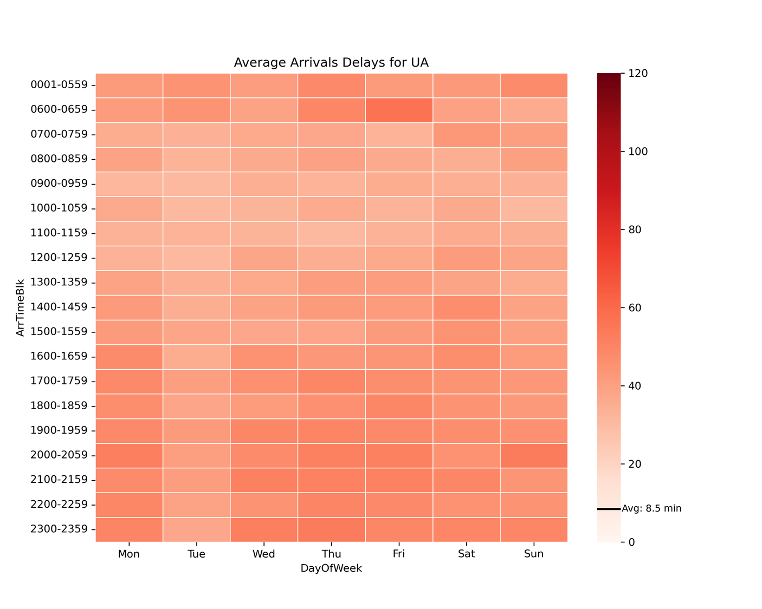
UA
Overall medium delays except on Tuesdays

Slide 11
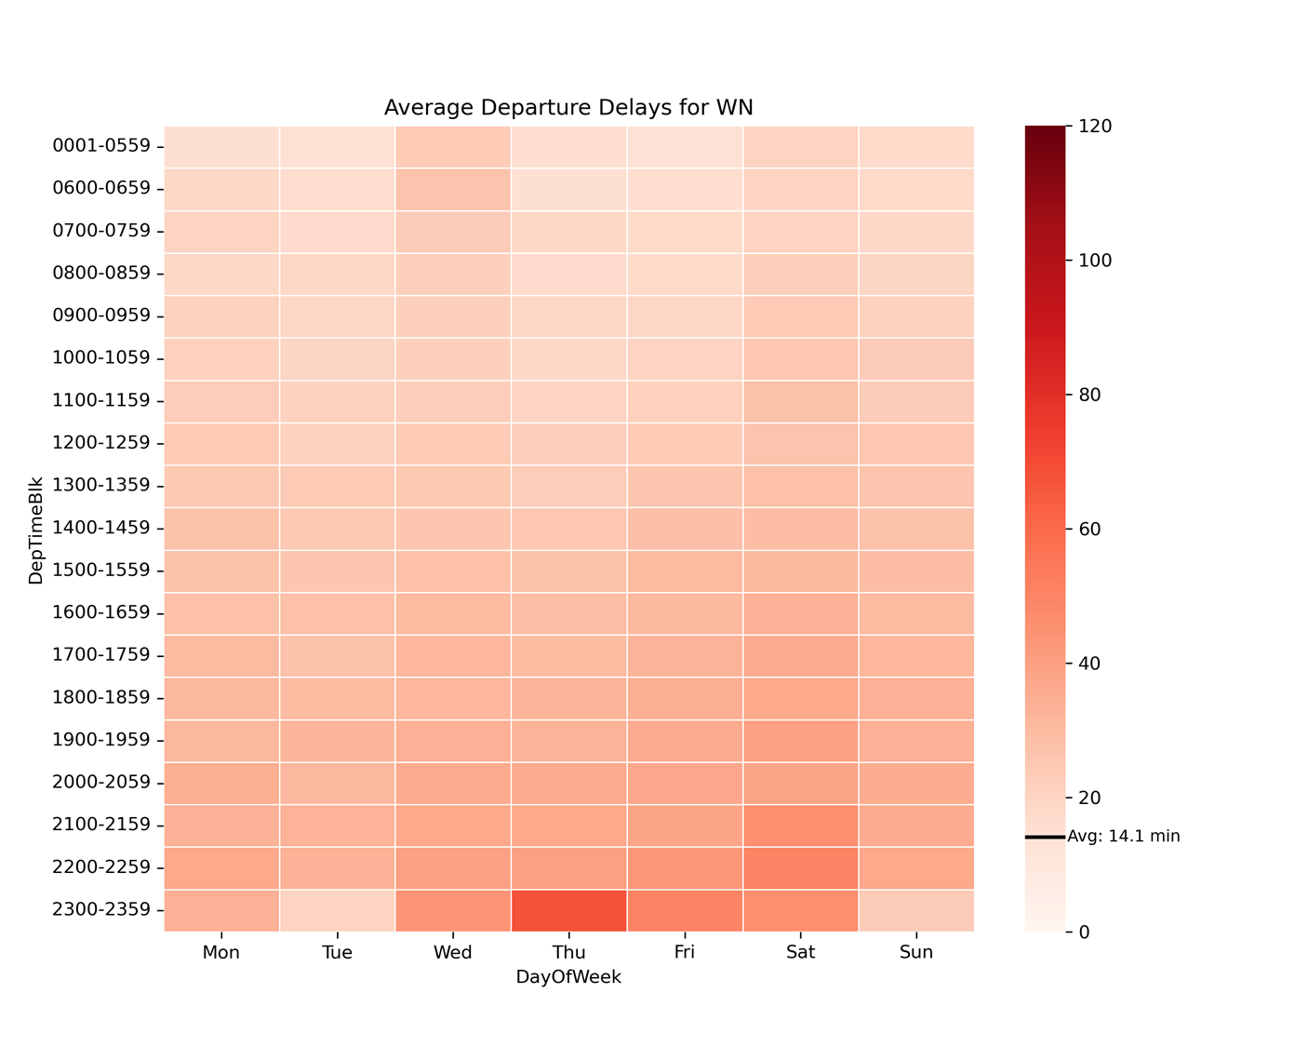
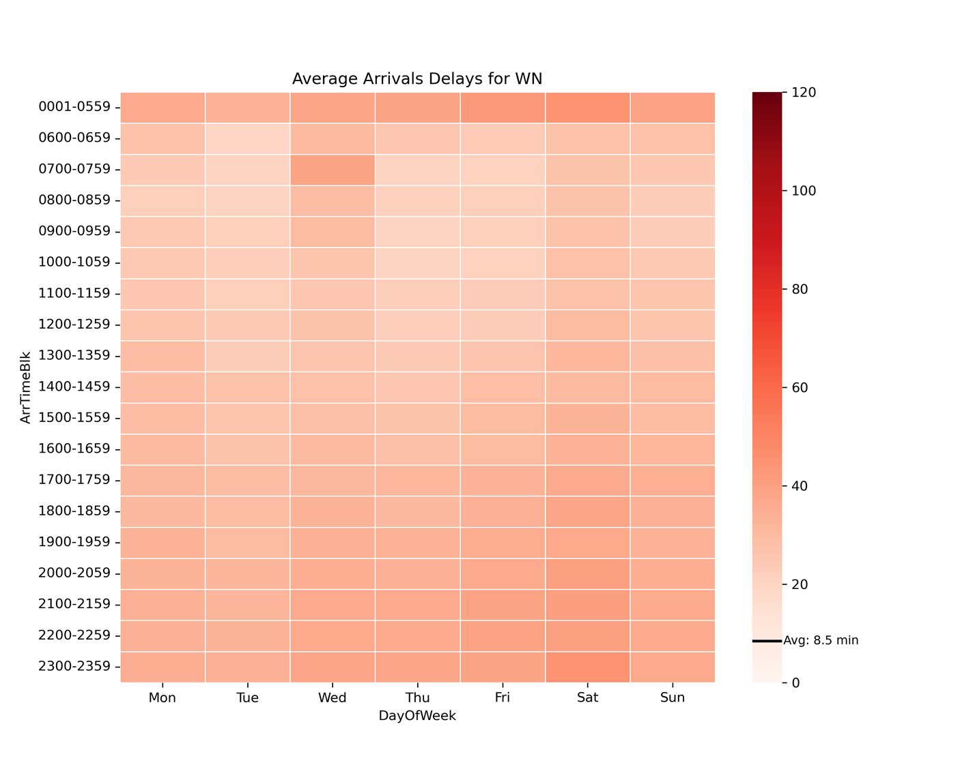
WN
Overall very short delays, except on Thursday nights and Saturday evenings

Slide 12
Recurring Arrival Delays Heatmaps
by Airline, Day of Week

Slide 15
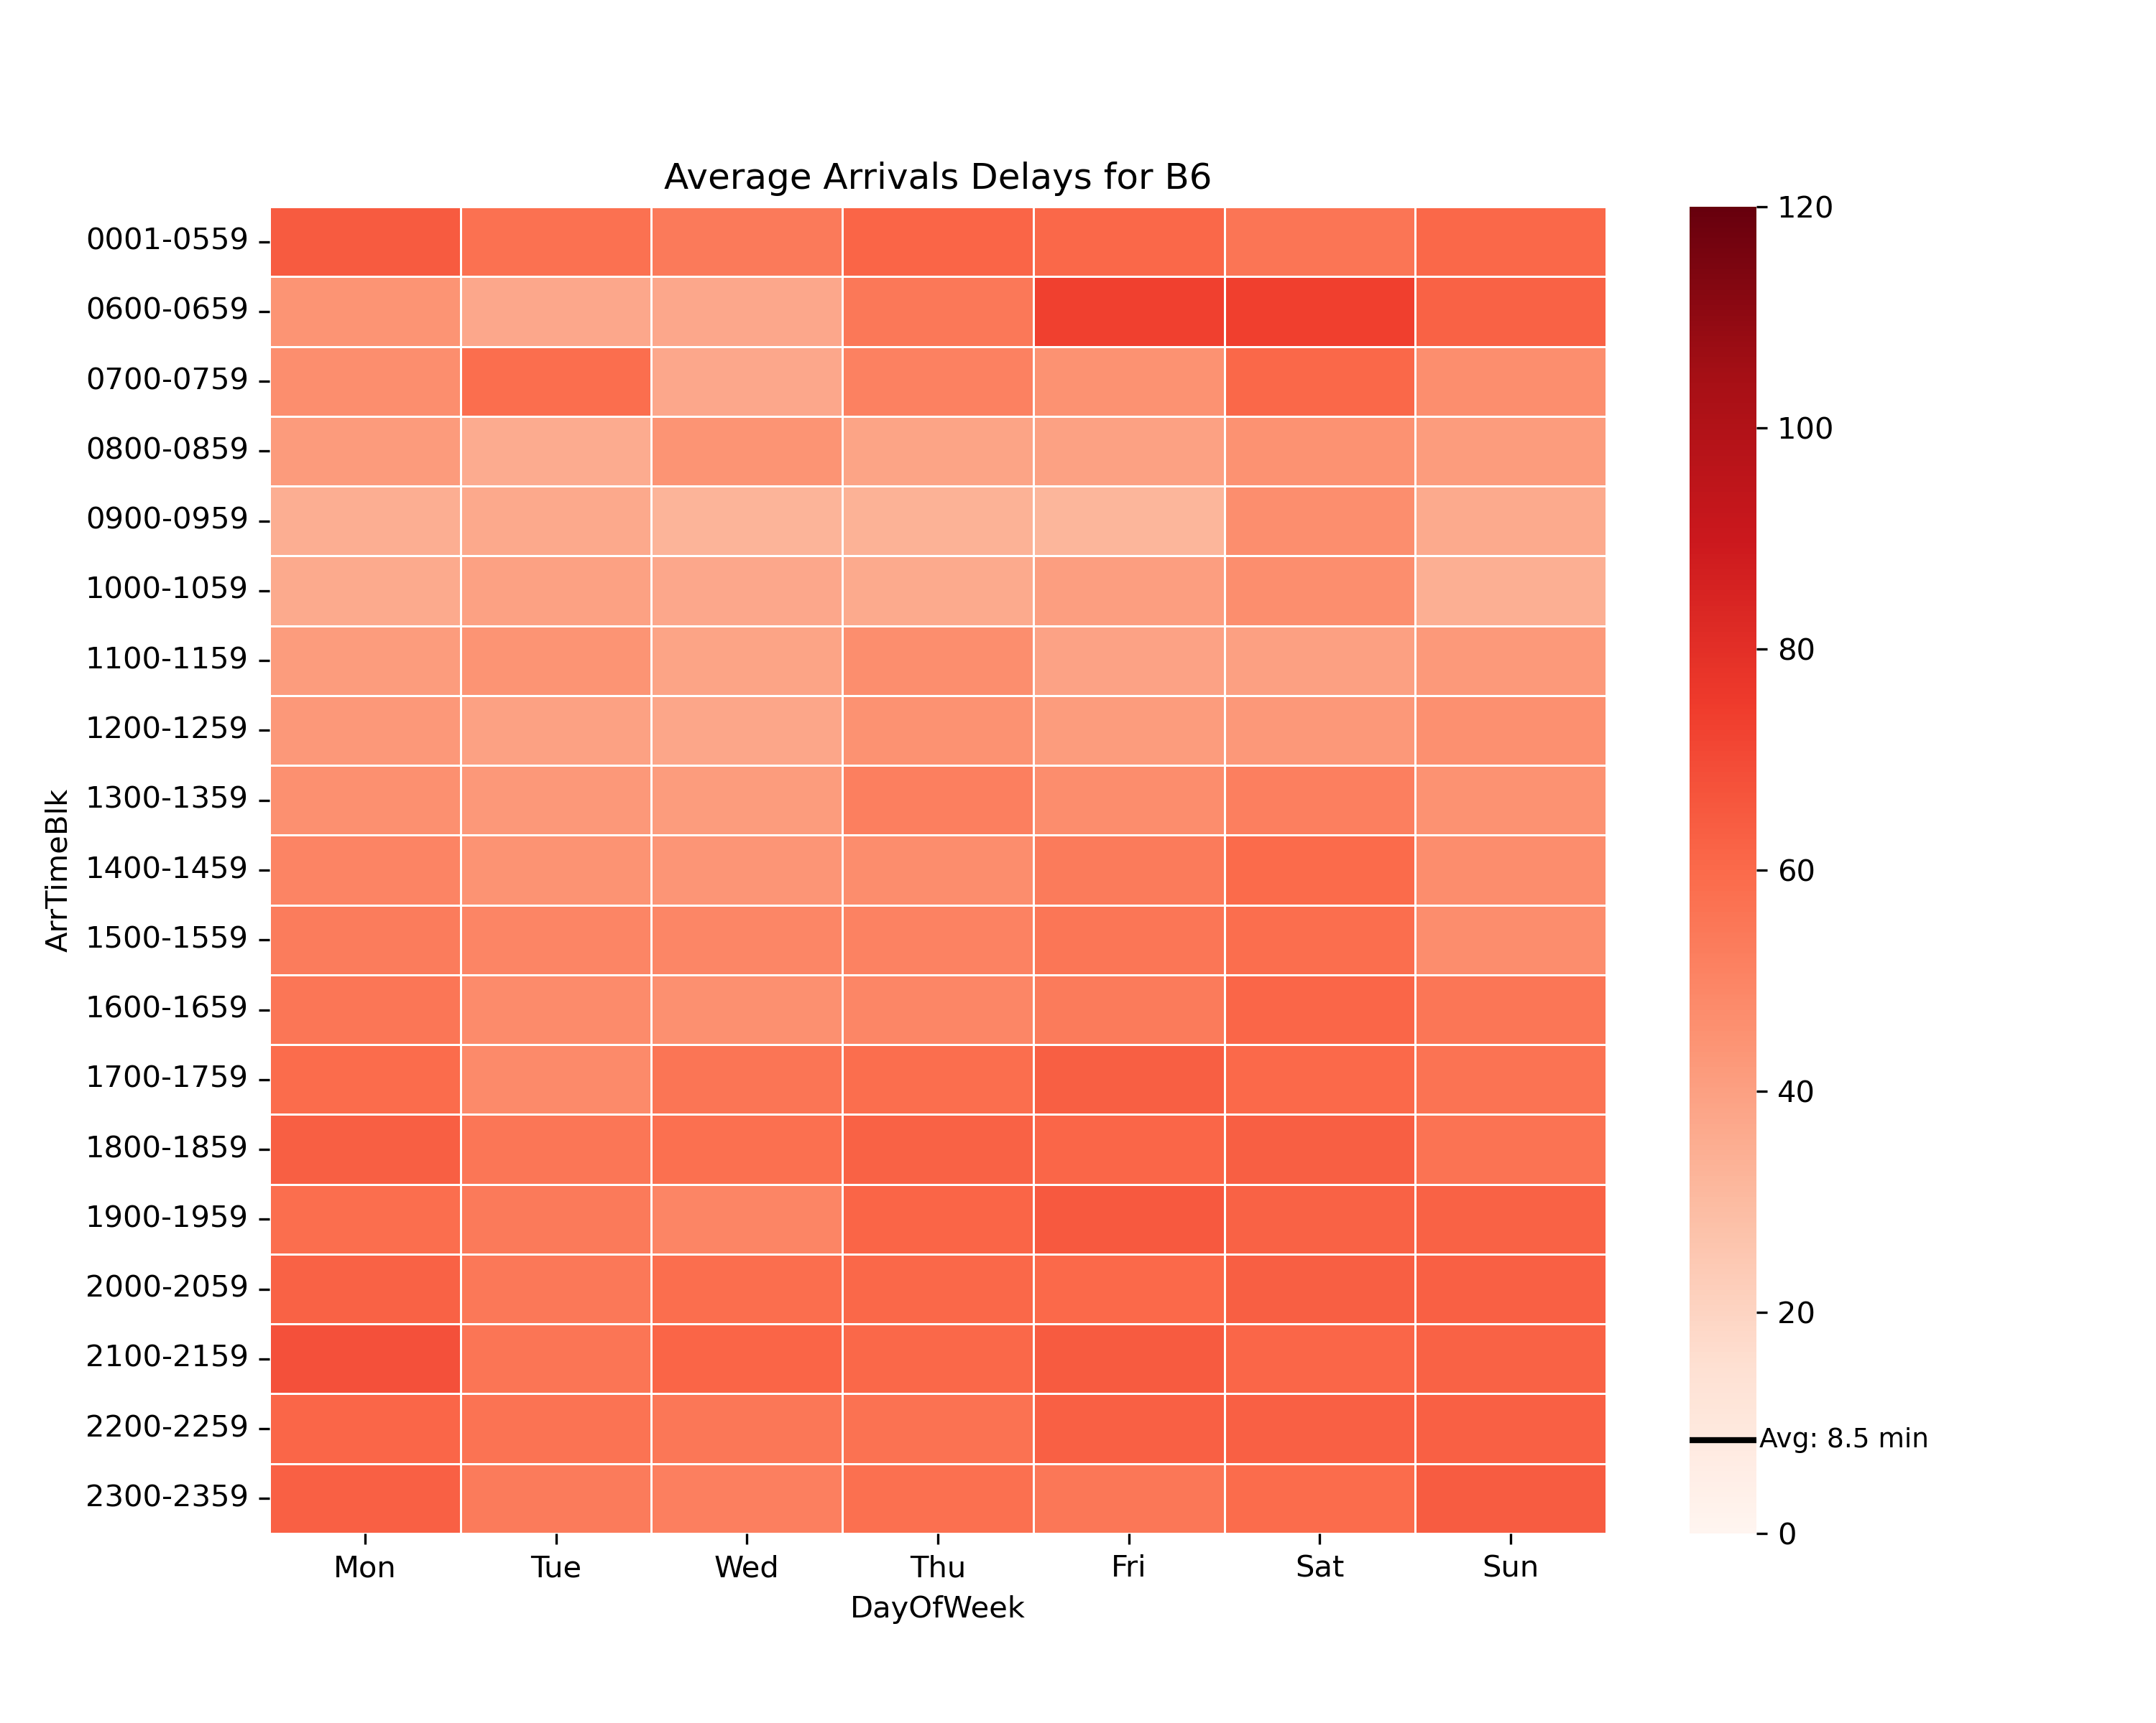

Slide 16
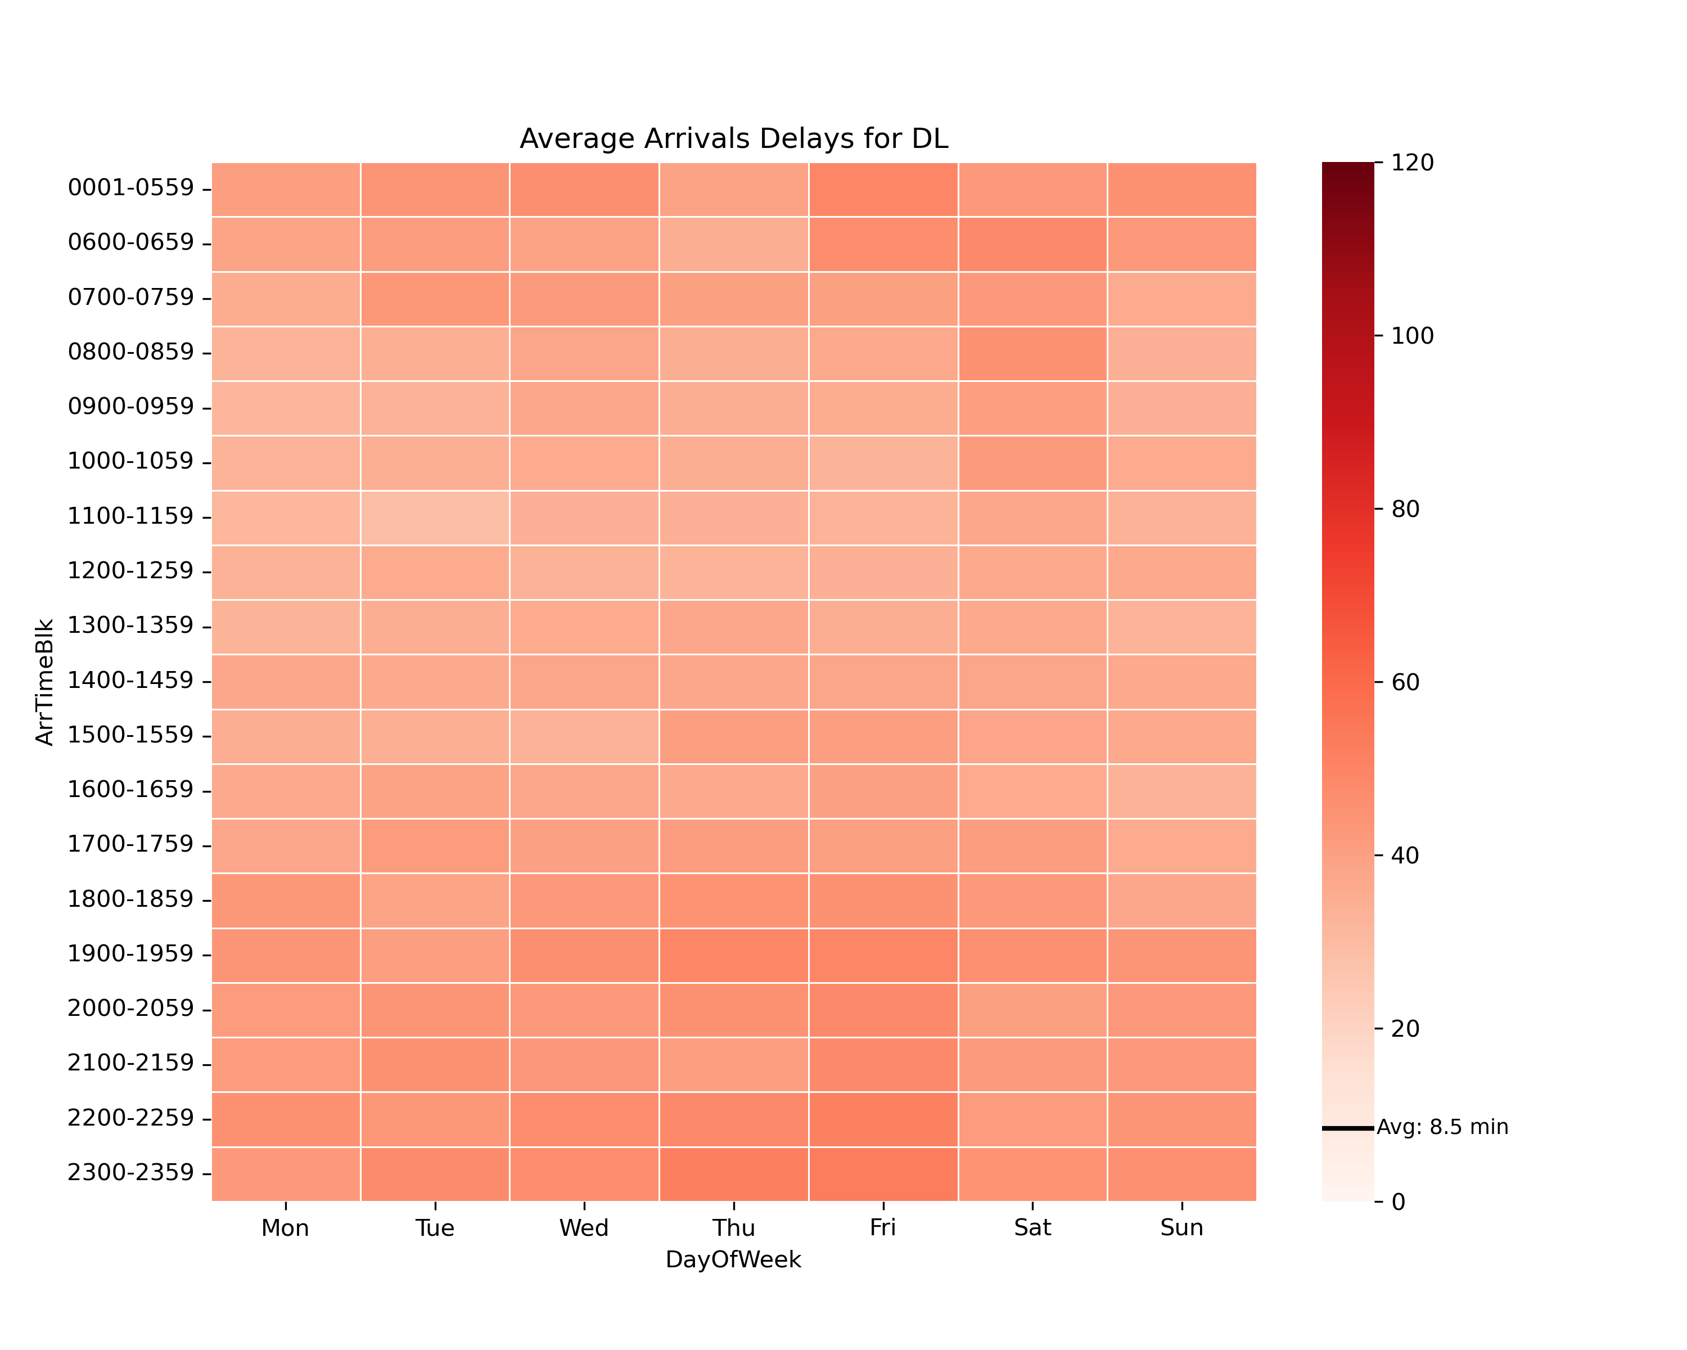

Slide 17
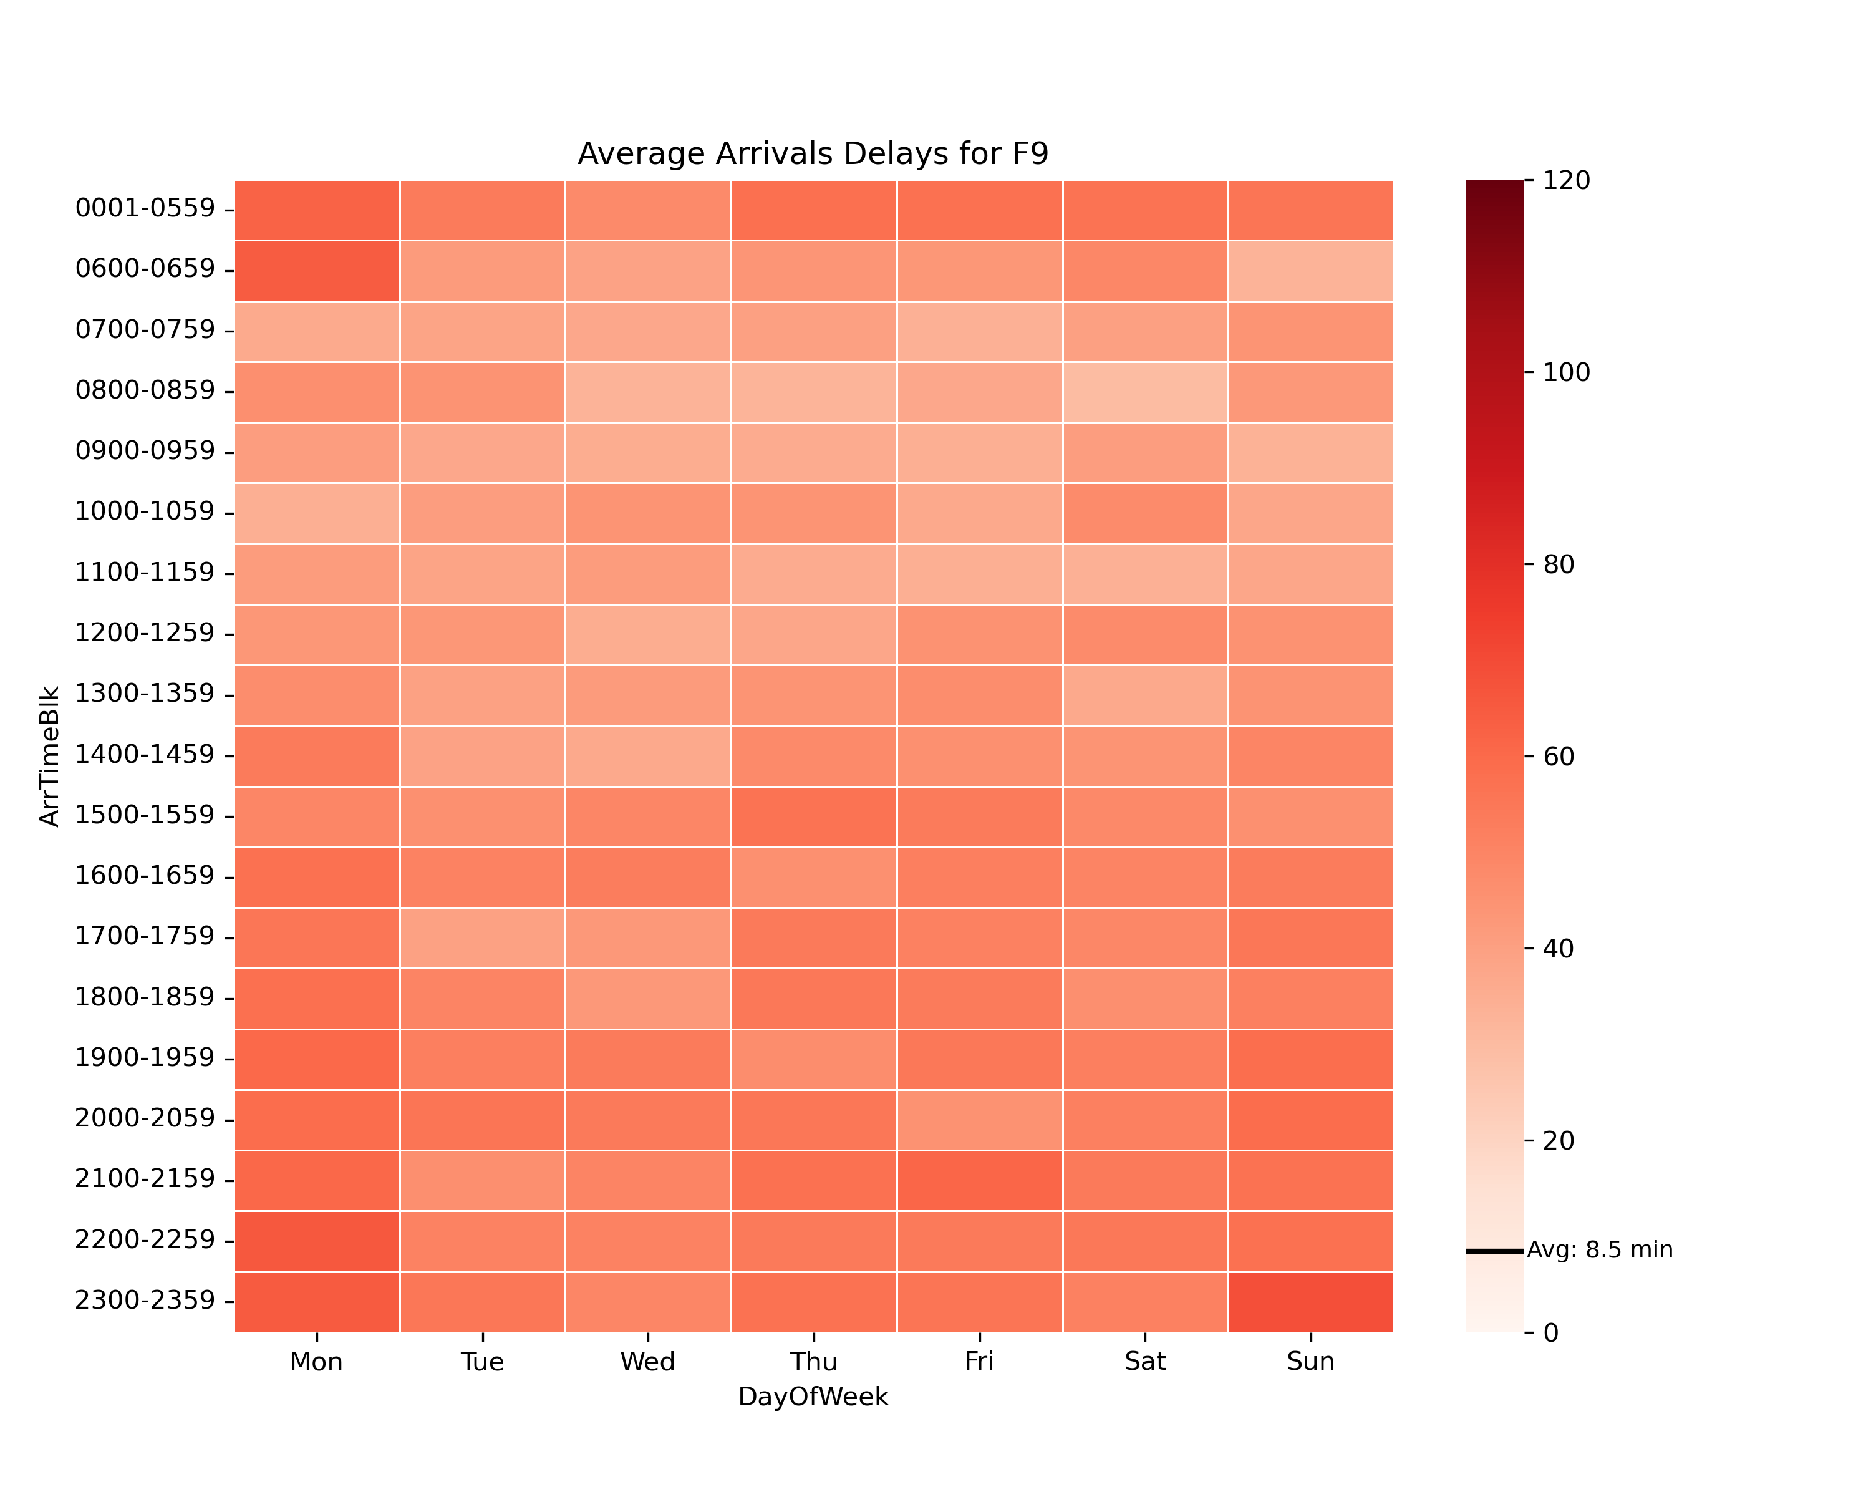

Slide 18


Slide 19


Slide 20
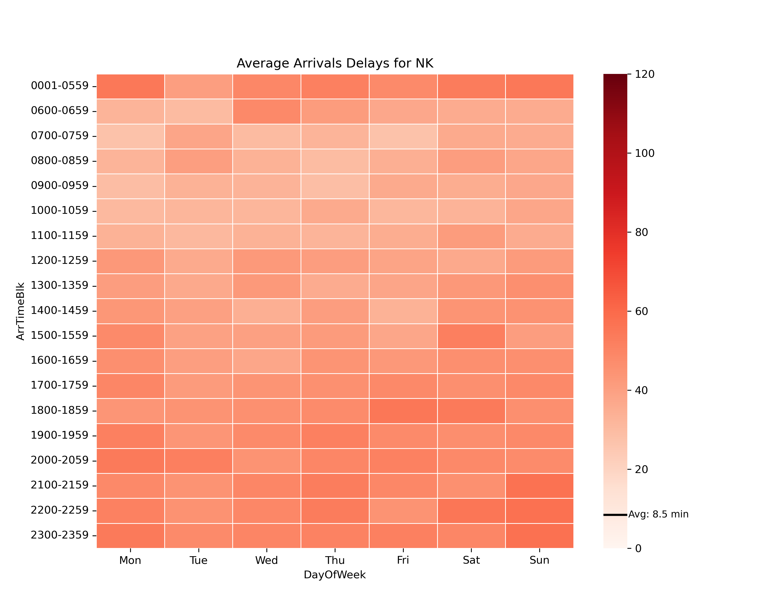

Slide 21
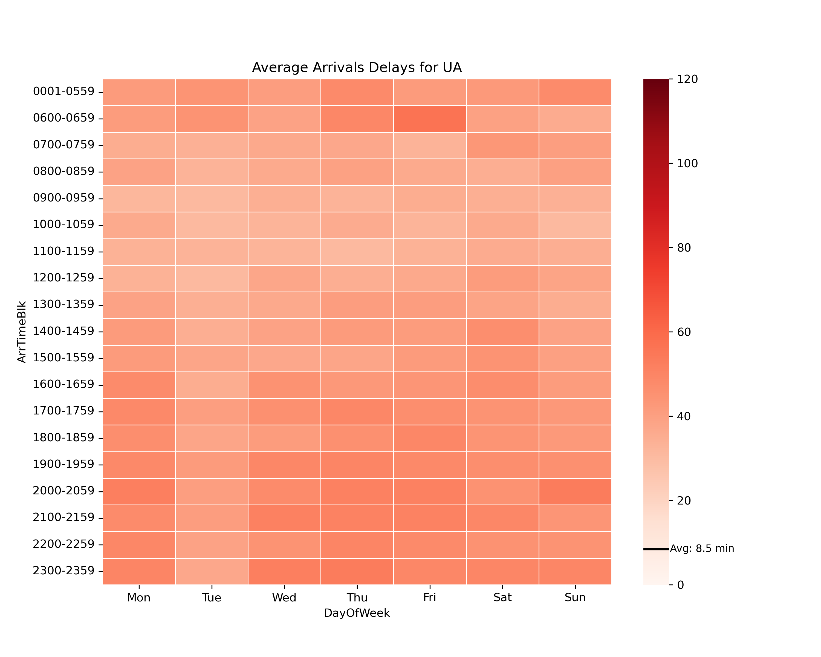

Slide 22


Slide 23
Recurring Delay Windows by Airline, Day of Week
Departures

Slide 25


Slide 26
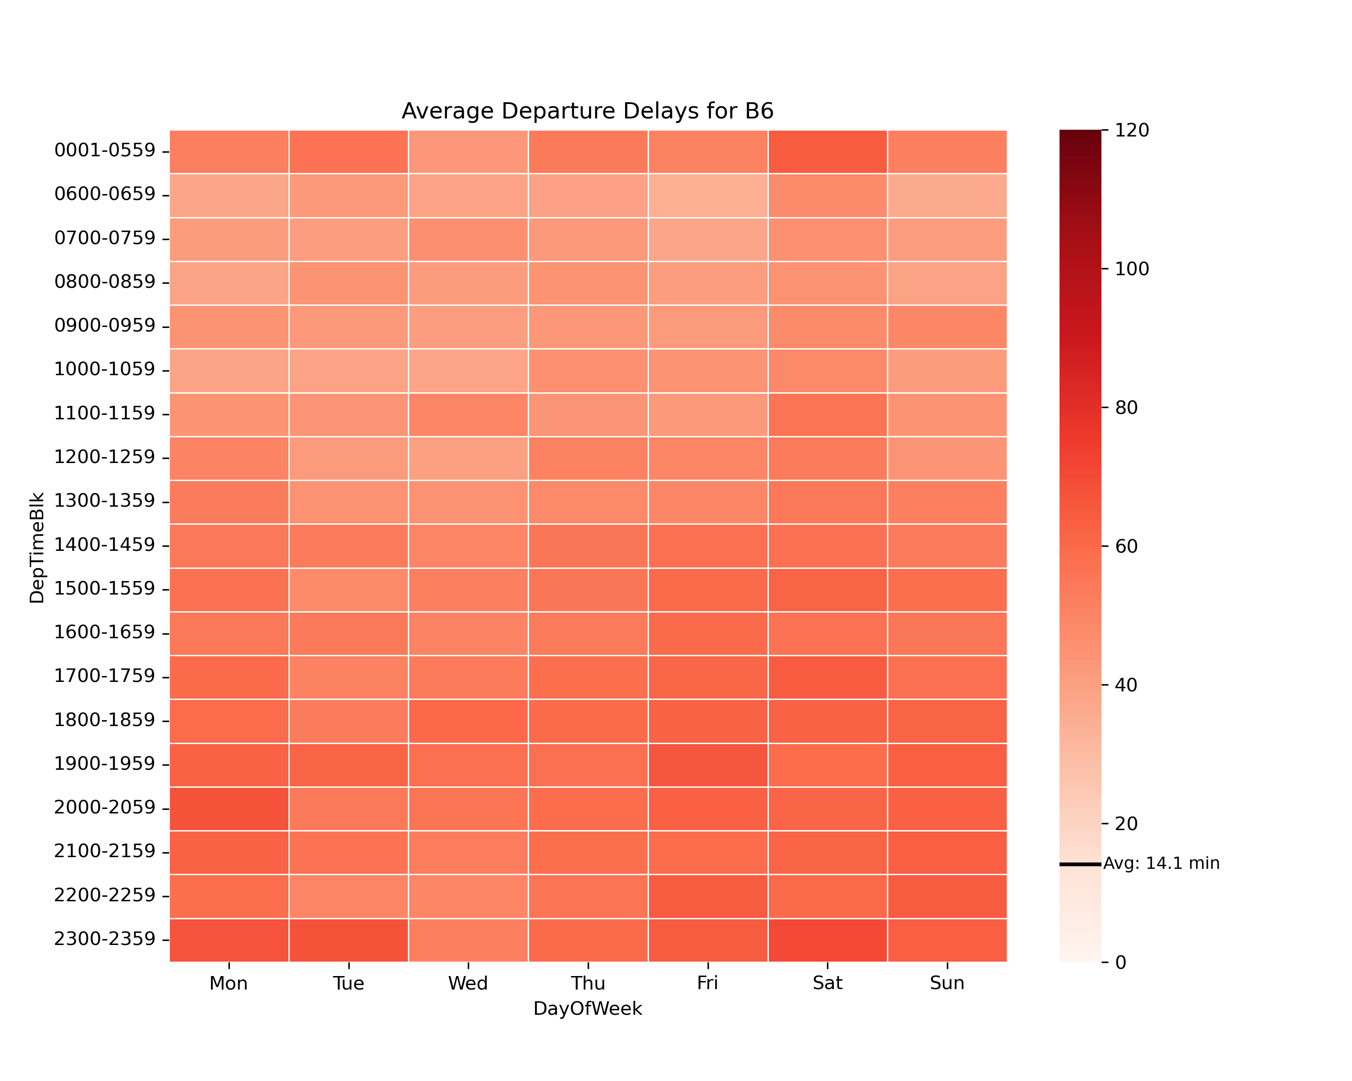

Slide 27
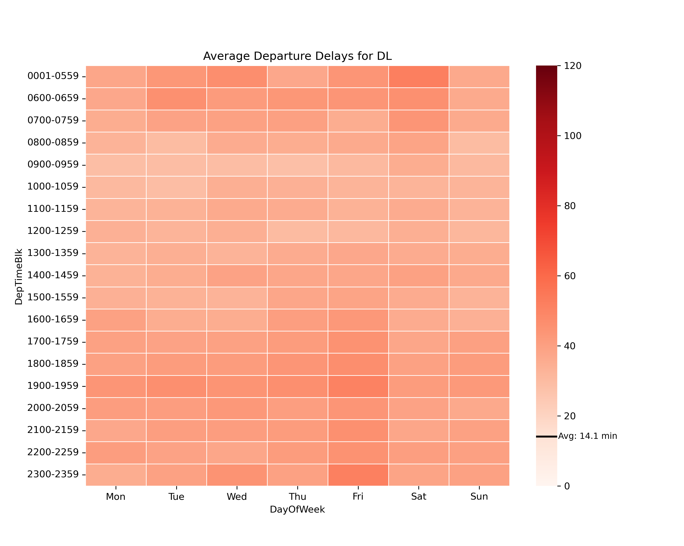

Slide 28
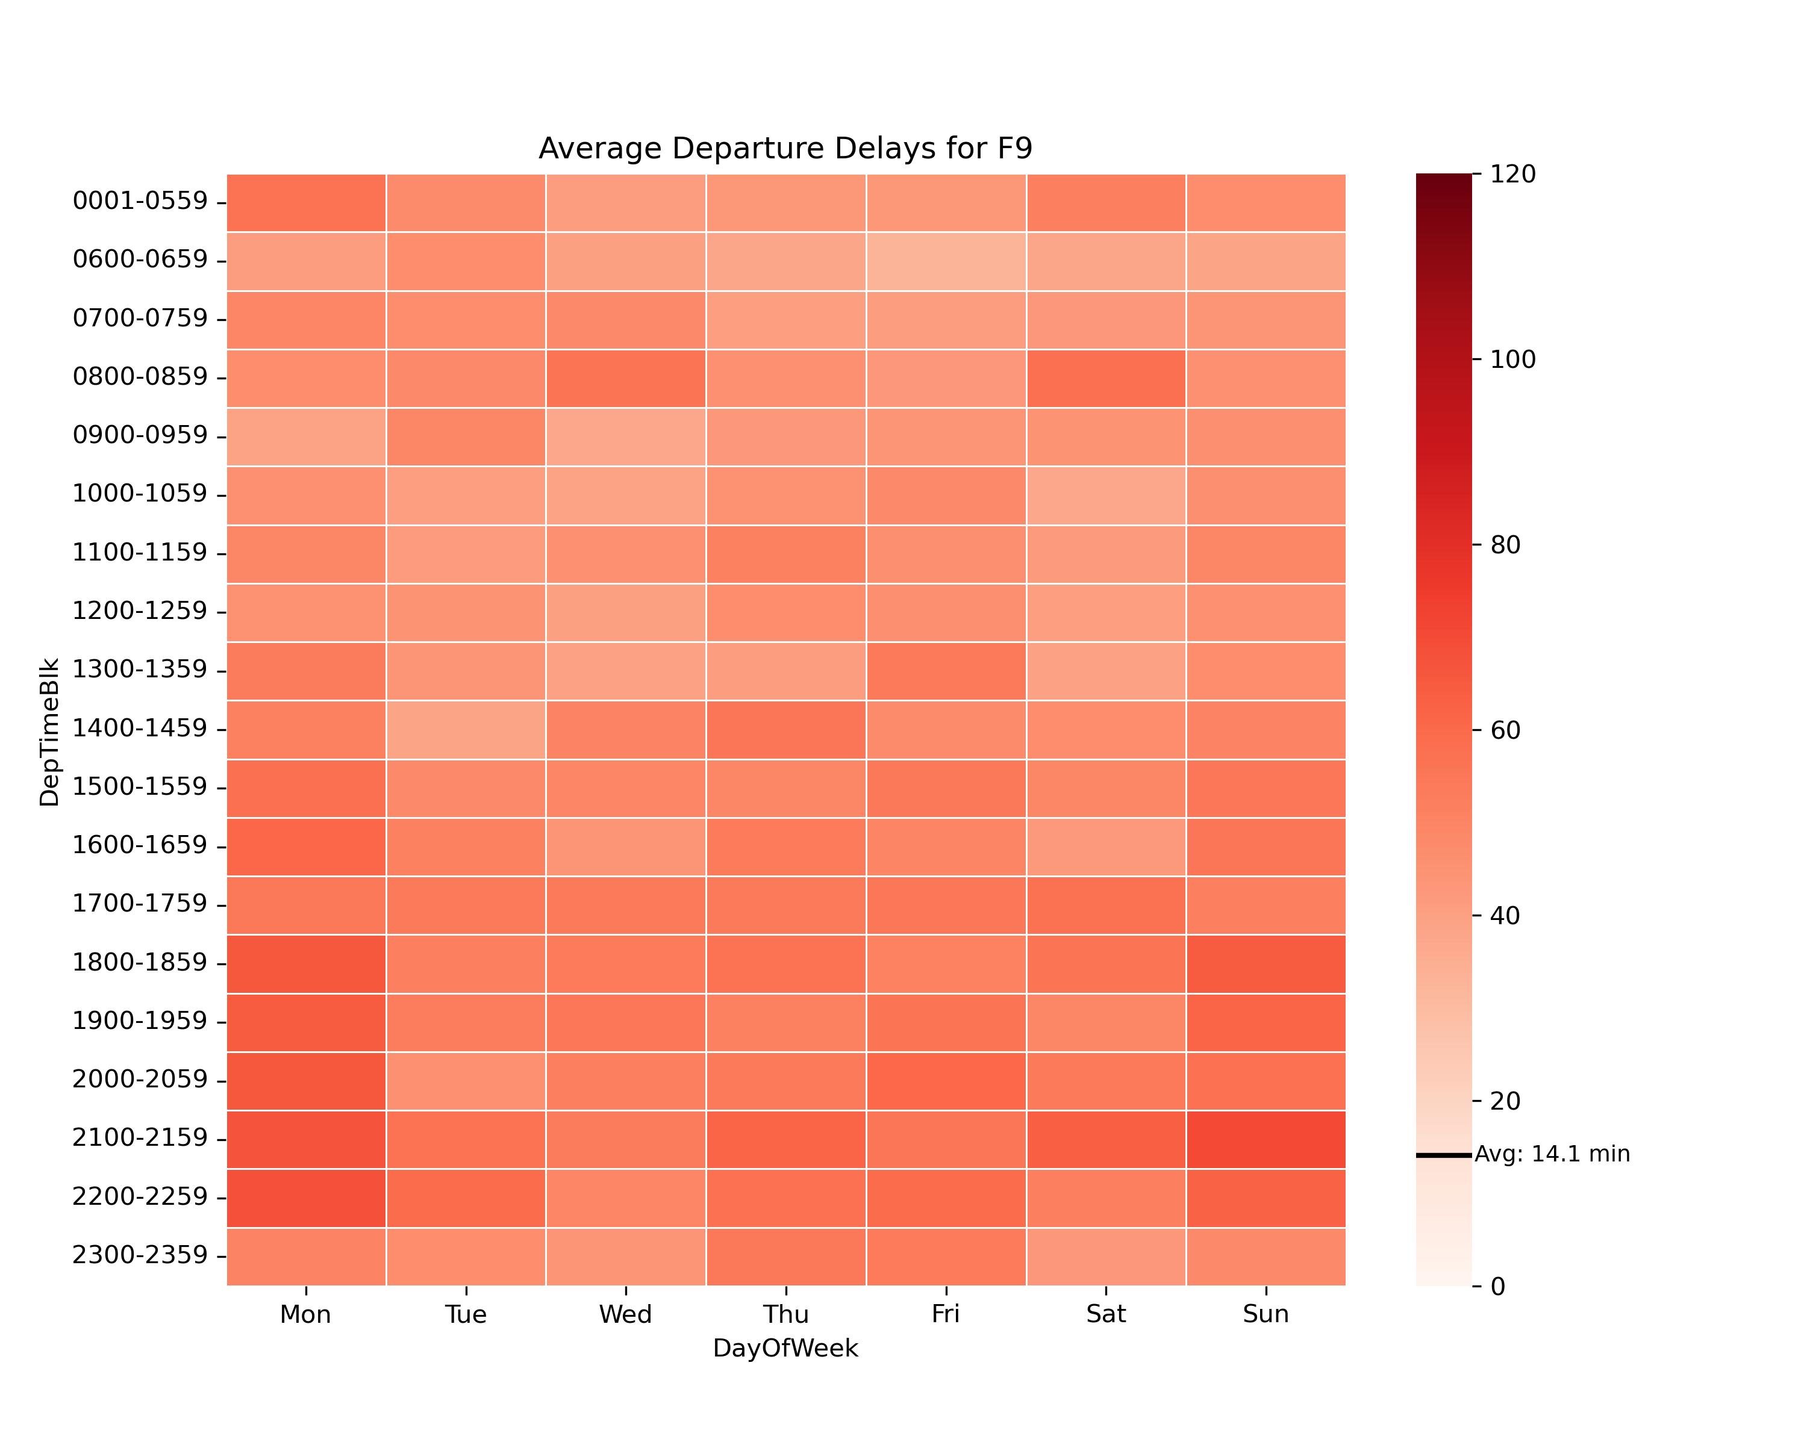

Slide 29


Slide 30


Slide 31
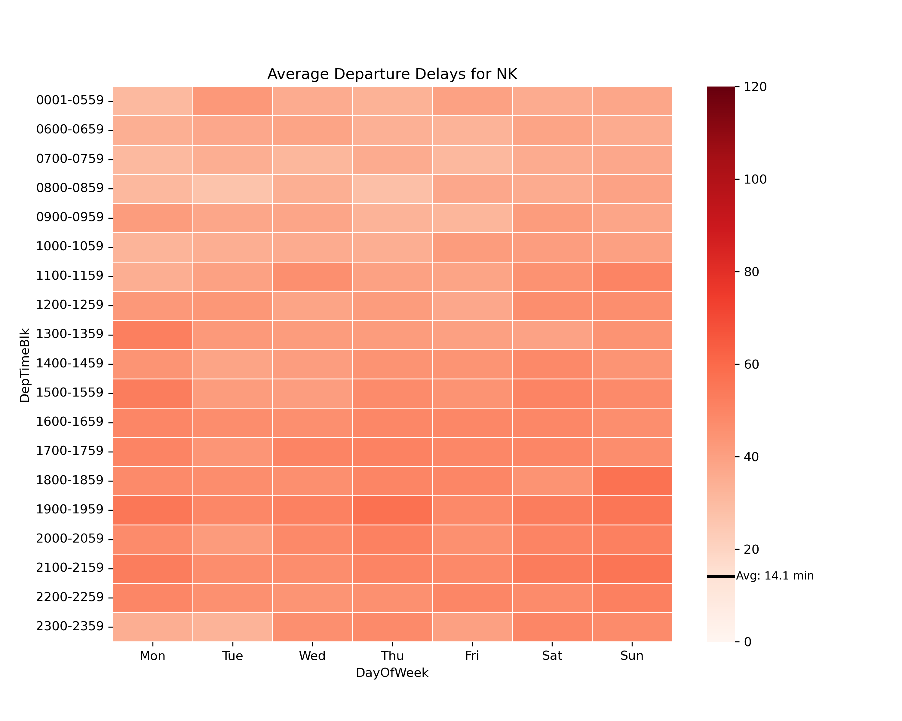

Slide 32
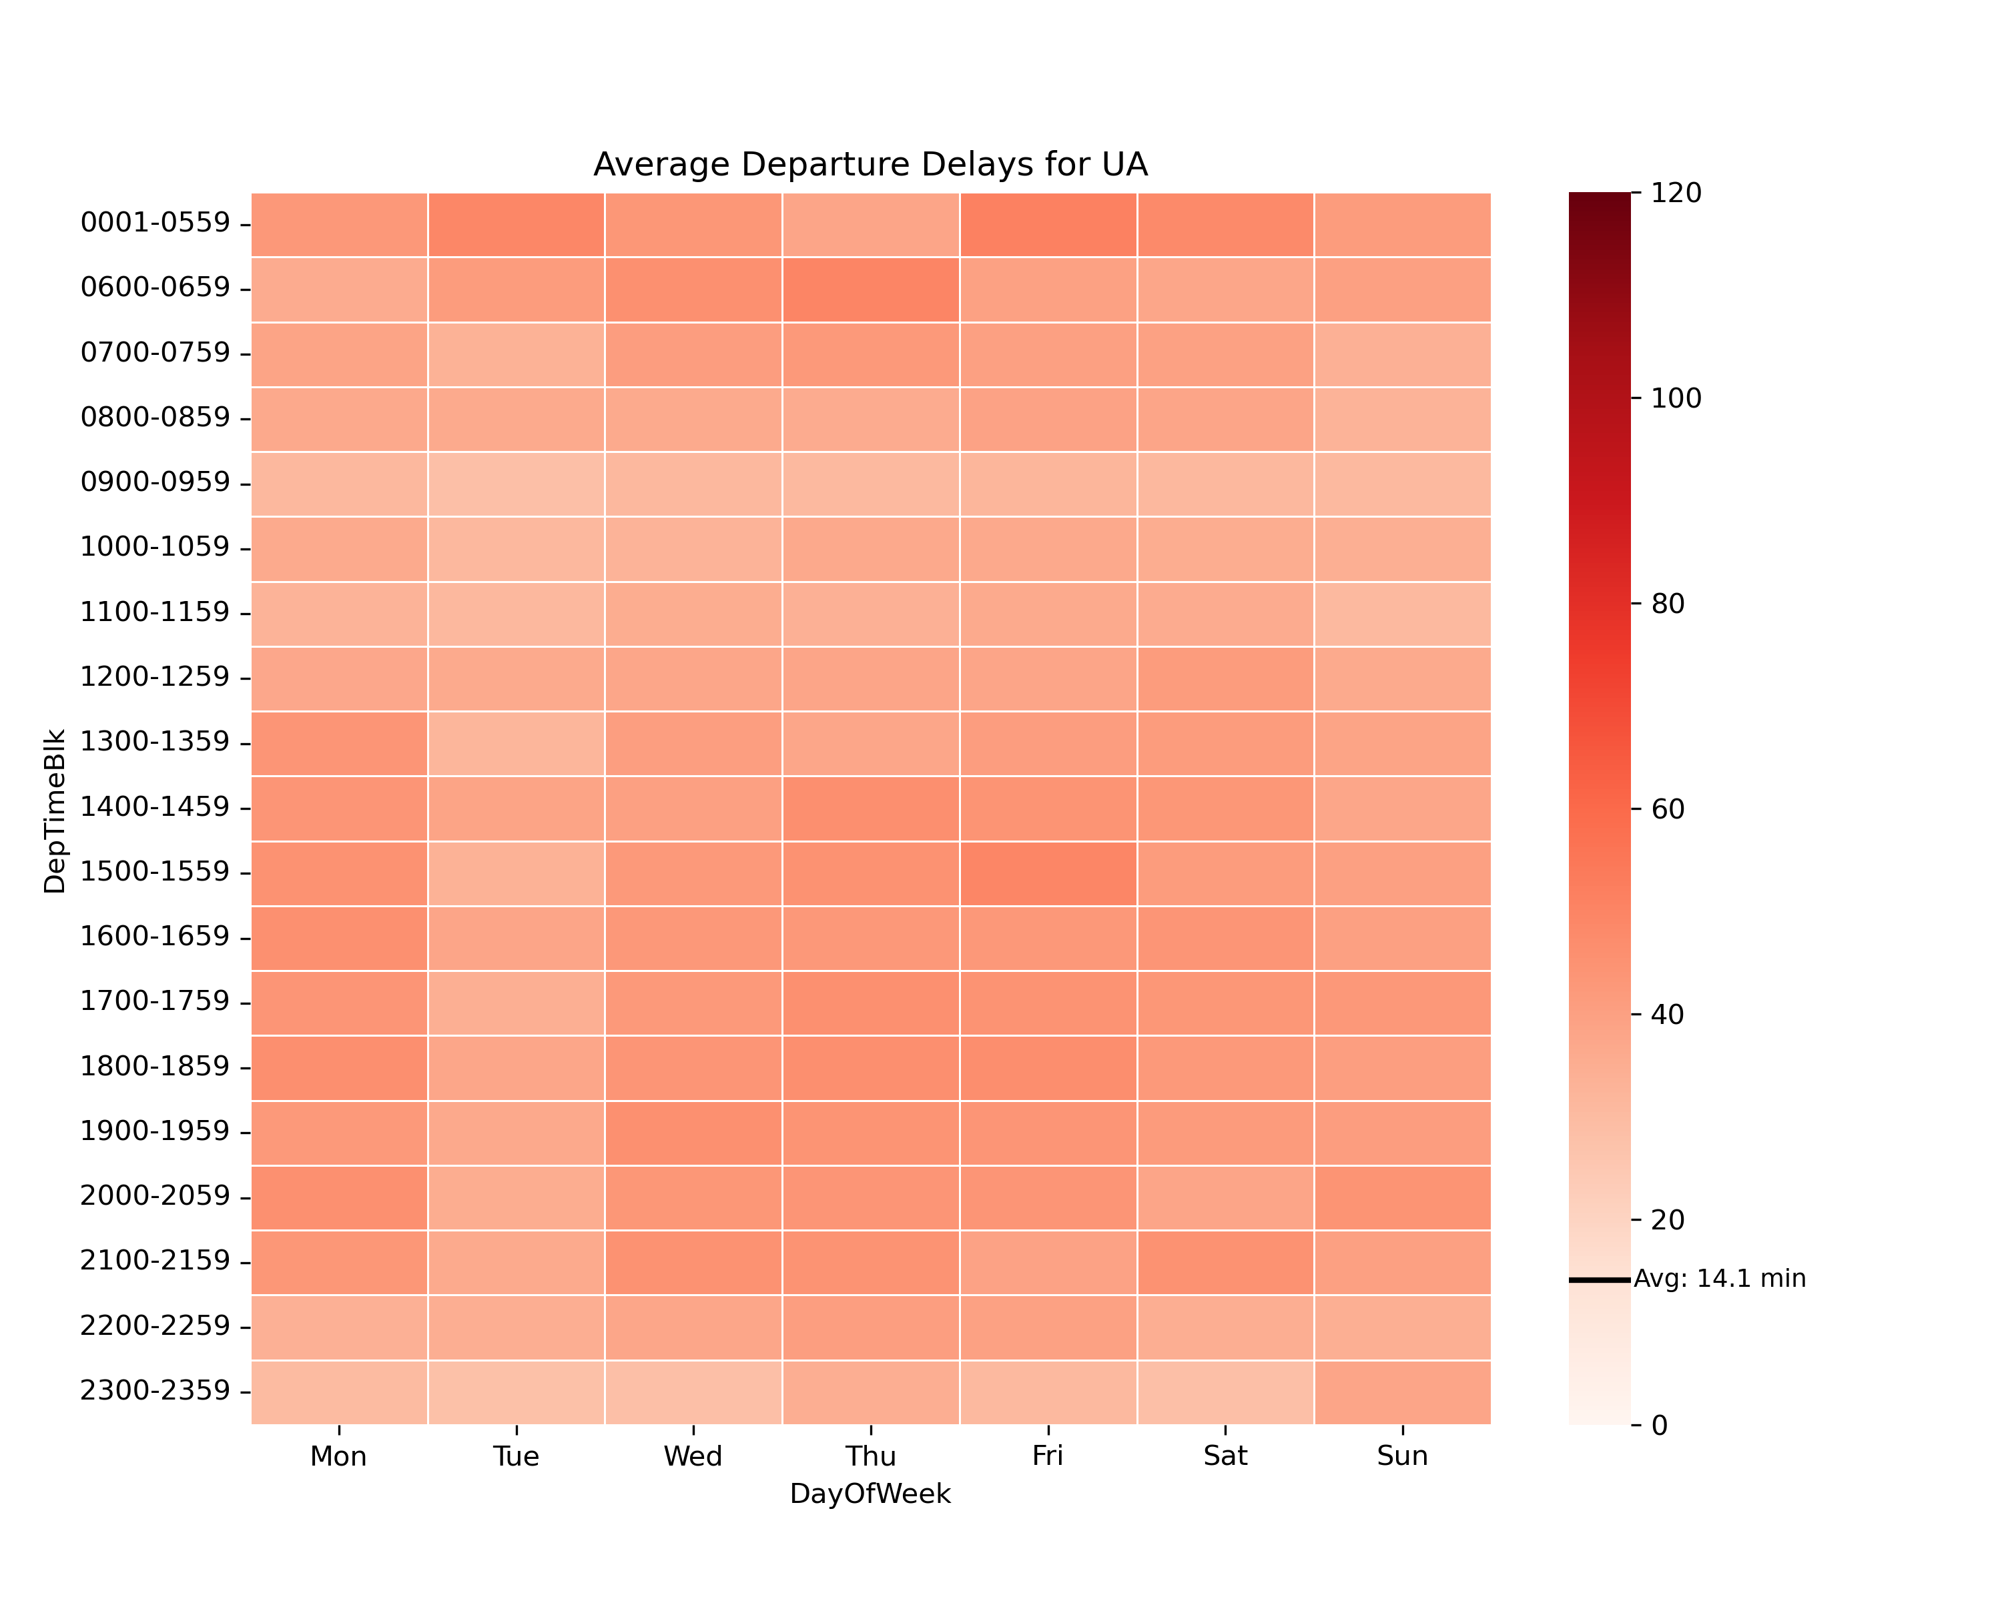

Slide 33


